Slide 1




Accounting for Dark-Dresses in Searches for GWs from Inspiraling PBHs Using Pattern-Recognition Techniques
Presented By:- Charchit Kumar Sethi
Supervisors:-
Collaborators:-
Dr. Andrew Miller
Dr. Sarah Caudill
Dr. P.S. Cole
Dr. B.J. Kavanagh
2nd New Horizons for Psi workshop,
25th Aug 2026

Slide 2
Outline:-
Primordial Black Holes as Dark Matter
Primordial Black Hole-Inspirals in Dark-Dresses
Binary Generalized Frequency Hough-V2
Grid Construction
Results
Summary & Outlook

Slide 3
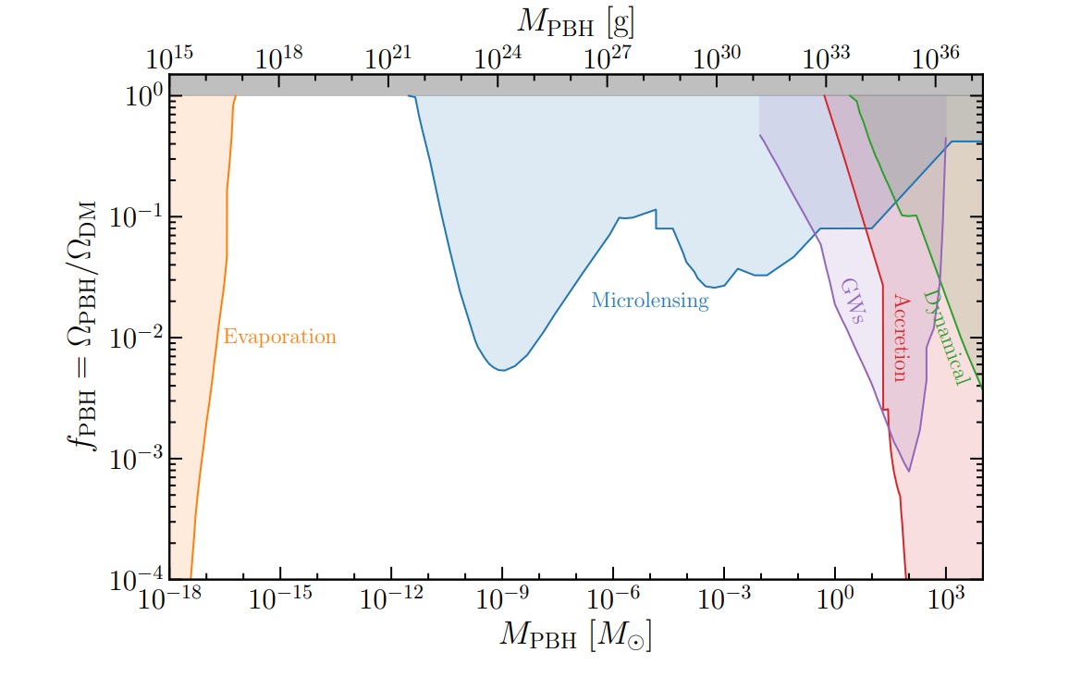
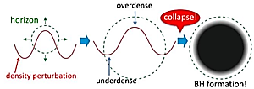
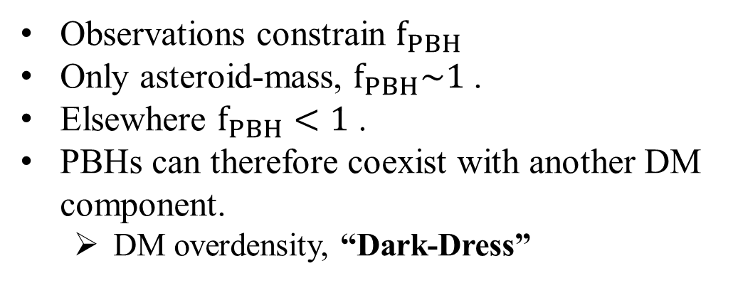
Primordial Black Holes as Dark-Matter Candidates
PBH Formation
PBHs As DM
Large overdensities PBHs.
Credit: Green et al.2020
Credit: Wikipedia.
Differ from stellar Black-Holes (BHs).
Wide range of masses.
Possible DM candidates.
Observations constrain $f_{PBH}$
Only asteroid-mass, $f_{PBH}\sim 1$ .
Elsewhere $f_{PBH}<1$ .
PBHs can therefore coexist with another DM component.
  DM overdensity, “Dark-Dress”

Slide 4
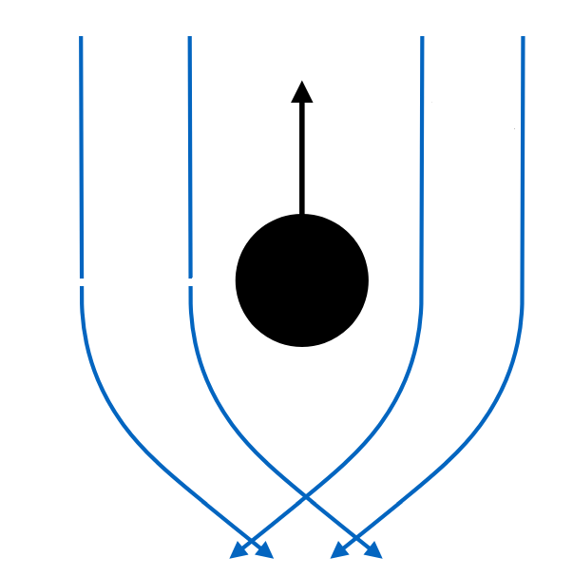
Dark-Dress and Their Impact On PBHs Inspirals
Dark-Dress (DD)
Dynamical Friction (DF)
Source: Bradley J Kavanagh.
“A surrounding DM overdensity forms a ‘dark dress’ around the PBH.”

Slide 5
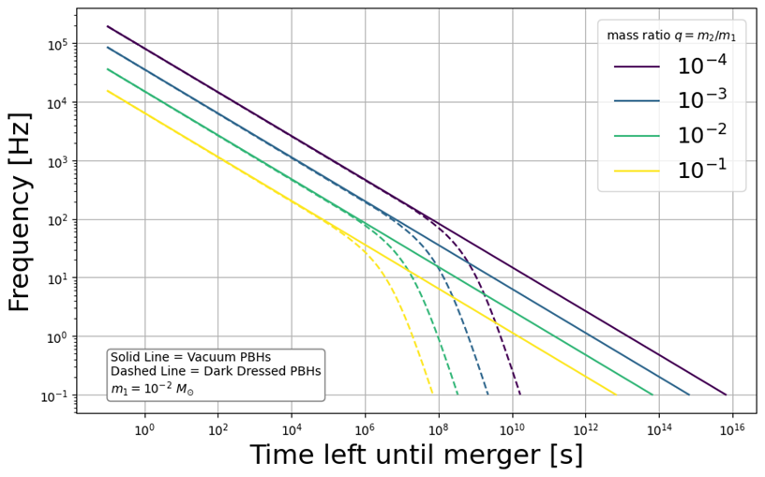
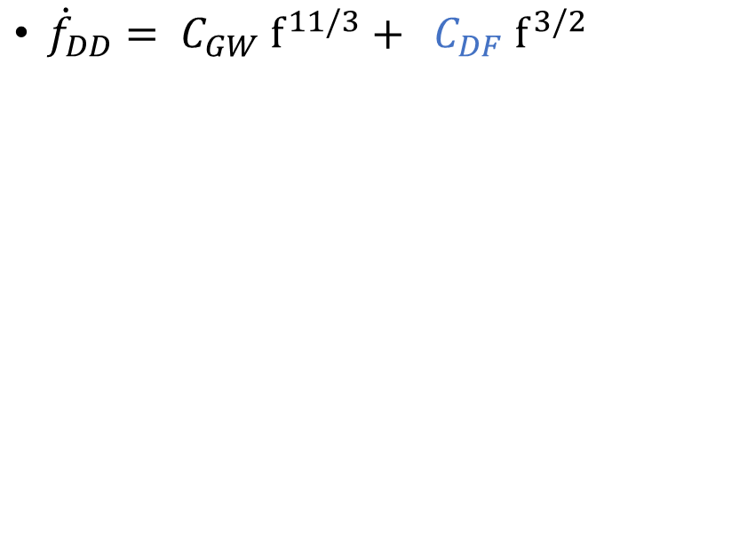
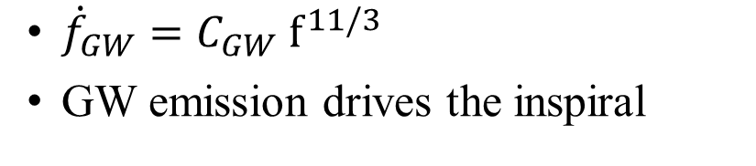
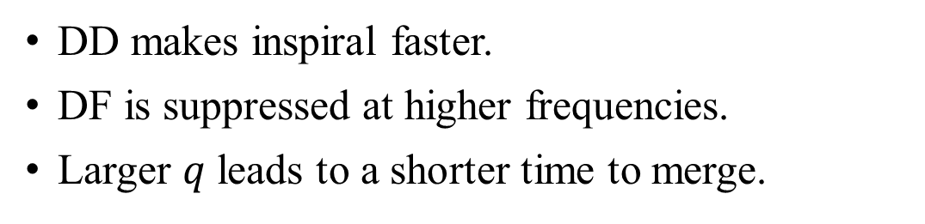
Frequency Evolution: Vacuum v/s Dark-Dress
Vacuum
Sethi, C.K., Master’s Thesis, (2025).
${\dot{f}}_{GW}=C_{GW} f^{11/3}$
GW emission drives the inspiral
Dark-Dress
${\dot{f}}_{DD}= C_{GW} f^{11/3}+ C_{DF} f^{3/2}$
Modifies the frequency evolution
DD makes inspiral faster.
DF is suppressed at higher frequencies.
Larger $q$ leads to a shorter time to merge.
Sethi, C. K . and ALM. In prep.

Slide 6
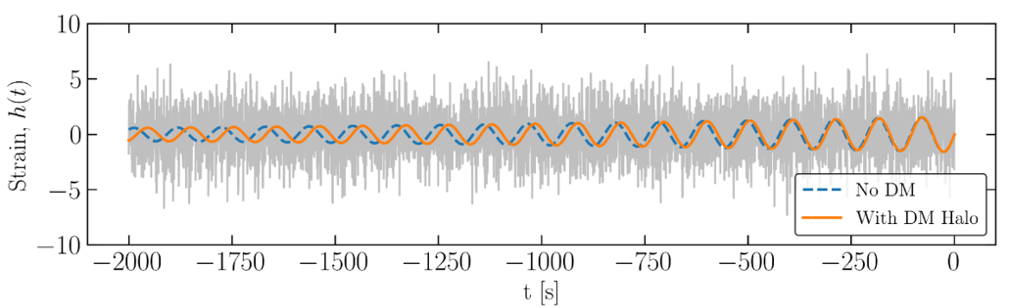
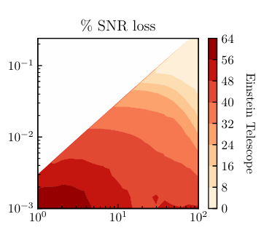


Why Does Dephasing Matter?
Dynamical friction modifies the waveform
$${−\dot{E}}_{orb}= {\dot{E}}_{GW}+ {\dot{E}}_{DF}$$
Additional energy loss
Modified frequency evolution
Vacuum and dark-dressed waveforms accumulate different phases. Credit: Bradley J Kavanagh
Accumulated phase difference
Dark-dressed waveforms dephase relative to vacuum.
Impact on matched filtering
• Phase mismatch → loss of recovered SNR
• Vacuum templates may miss DD signals
• DD parameters → larger template banks → higher cost
DD-induced phase mismatch can significantly reduce recovered SNR. Cole et al. 2022.
Dephasing motivates a search that does not require precise phase tracking → BinaryGFH-V2

Slide 7
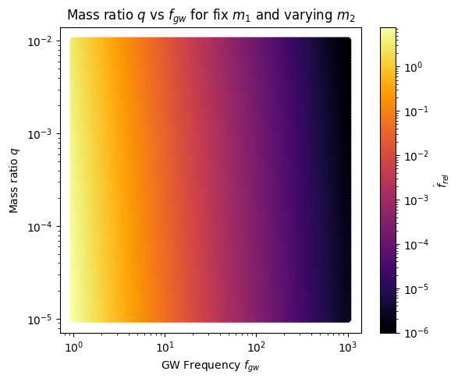
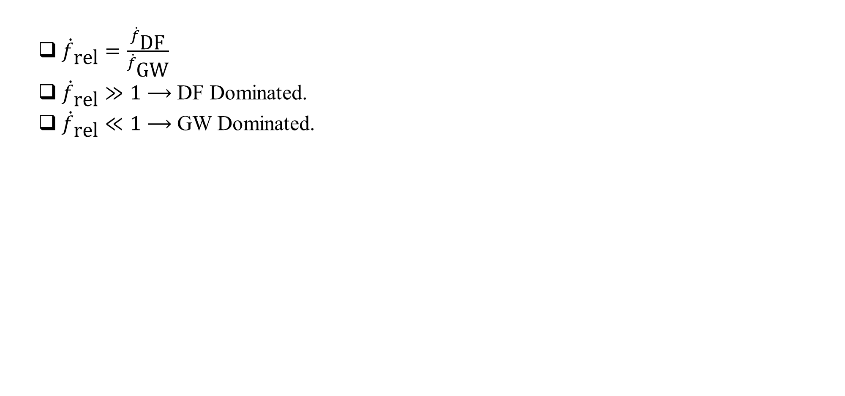
When does DF Matter?
  ${\dot{f}}_{\text{rel}}=\frac{{\dot{f}}_{\text{DF}}}{{\dot{f}}_{\text{GW}}}$
  ${\dot{f}}_{\text{rel}}≫1⟶$ DF Dominated.
  ${\dot{f}}_{\text{rel}}≪1⟶$ GW Dominated.
Takeaway:
• DF matters mainly below ~10 Hz
• Above ~10 Hz, GW emission dominates
• More relevant for ET/CE than current LIGO band
Fixed $m_{1}=1Μ_{⨀}$ & varying $m_{2}=({10}^{−5} −{10}^{−2})Μ_{⨀}$
Sethi, C.K., Master’s Thesis, (2025).
Sethi, C. K . and ALM. In prep.

Slide 8
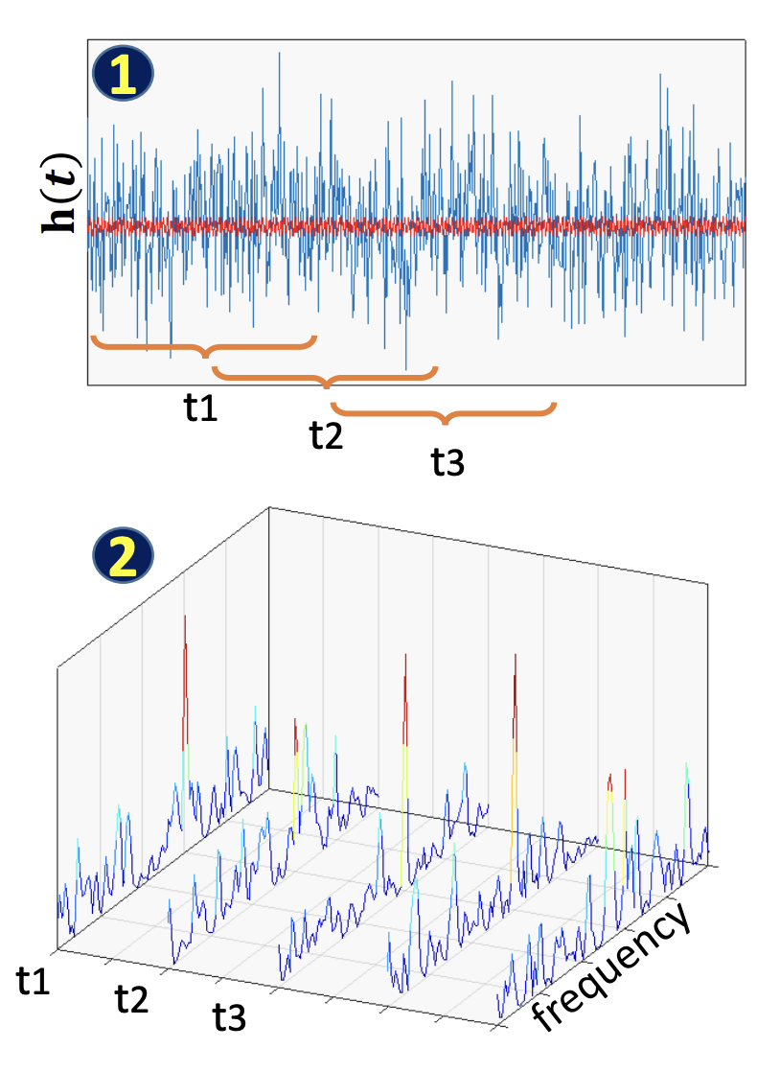
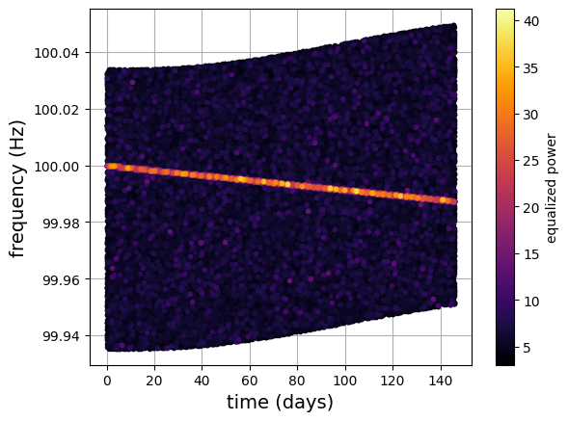
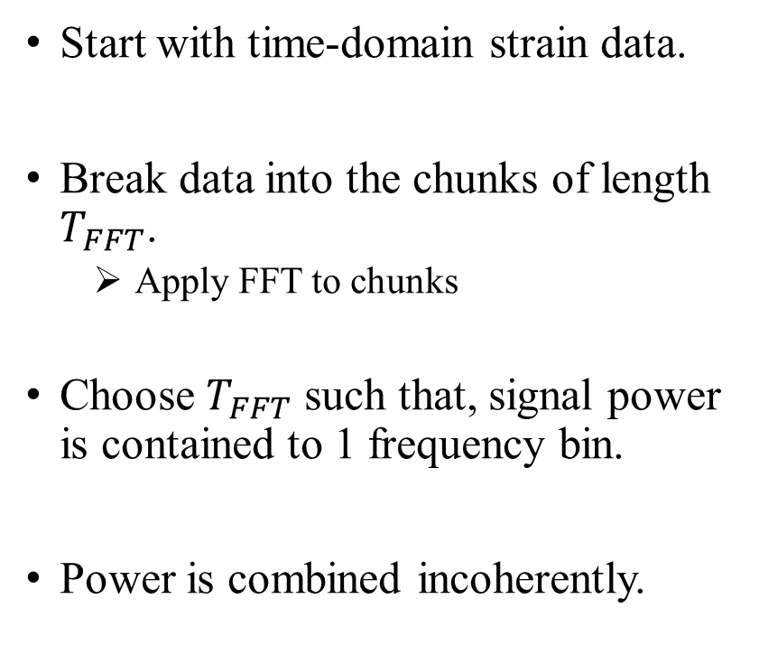
Semi-Coherent Search
CW searches can’t rely on matched filtering;
  Making it computationally expensive.
Start with time-domain strain data.
Break data into the chunks of length $T_{FFT}$.
  Apply FFT to chunks
Choose $T_{FFT}$ such that, signal power is contained to 1 frequency bin.
Power is combined incoherently.
Credit: Andrew Miller.
Credit: L. Pierini.

Slide 9
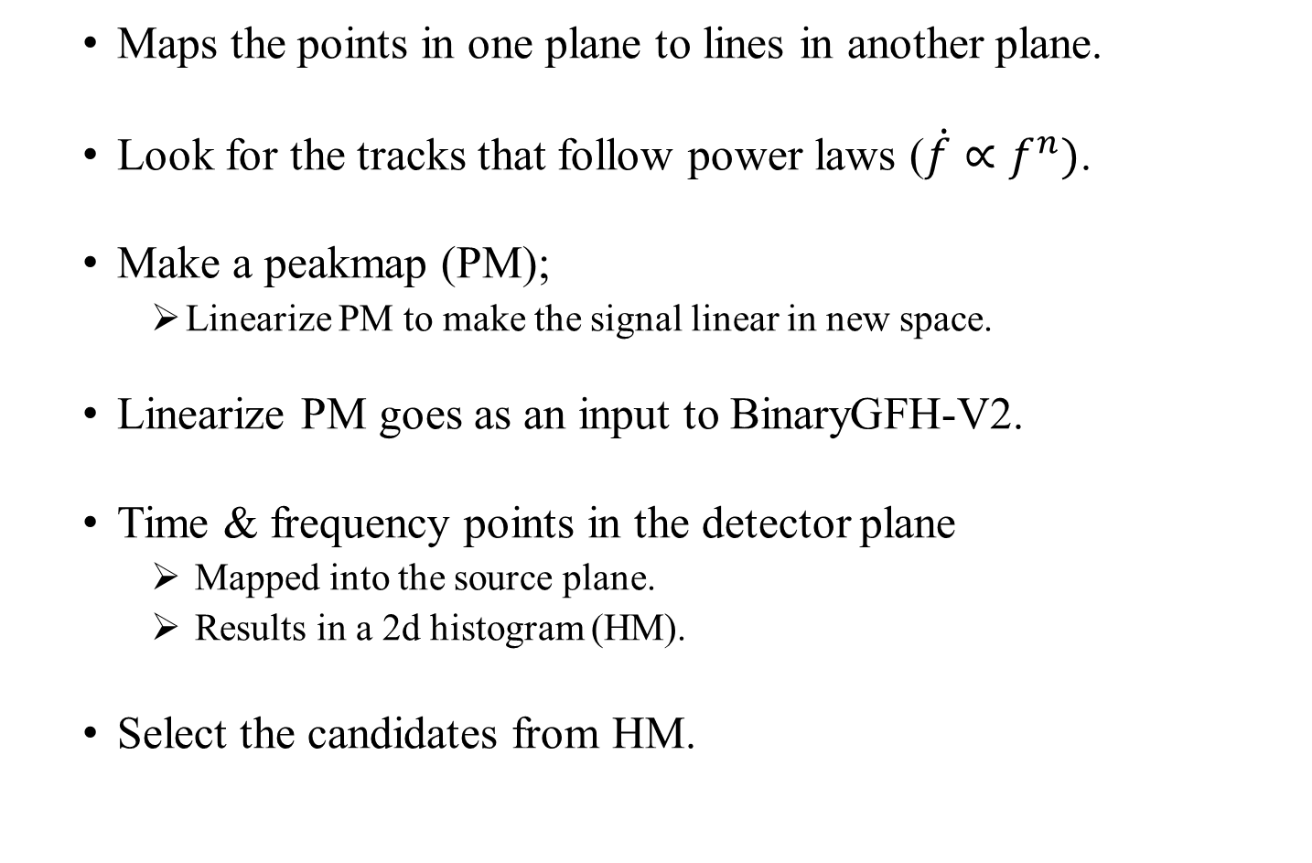
BinaryGFH-V2
Peakmap
  Maps the points in one plane to lines in another plane.
  Look for the tracks that follow power laws ($\dot{f}∝f^{n})$.
  Make a peakmap (PM);
    Linearize PM to make the signal linear in new space.
  Linearize PM goes as an input to BinaryGFH-V2.
  Time & frequency points in the detector plane
    Mapped into the source plane.
    Results in a 2d histogram (HM).
  Select the candidates from HM.
Linearize the Peakmap
Hough Map (HM)
Select significant candidates in the HM

Slide 10
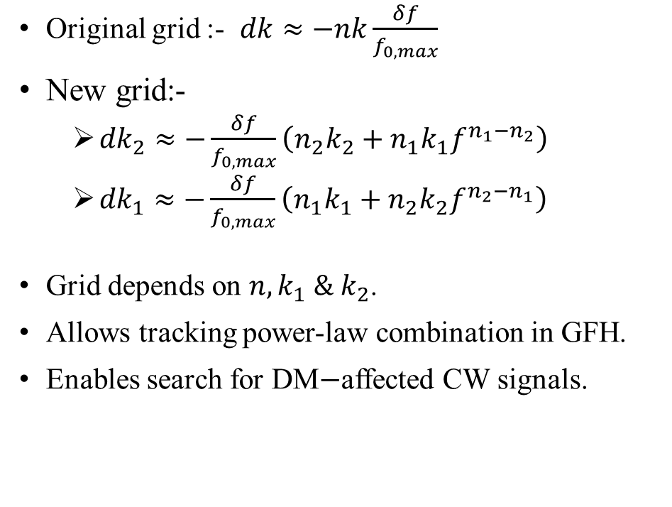
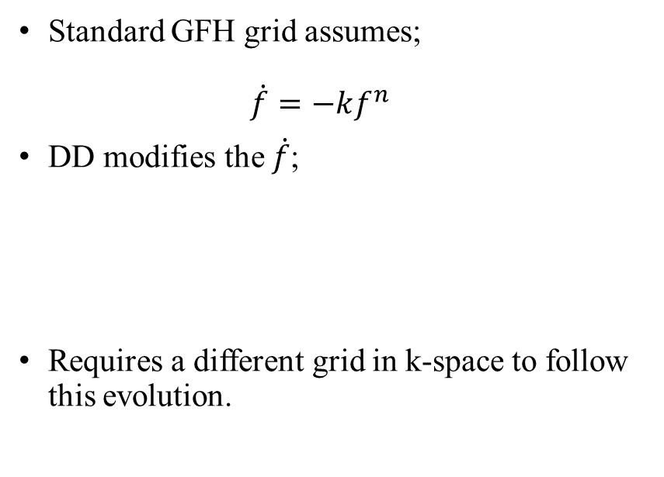
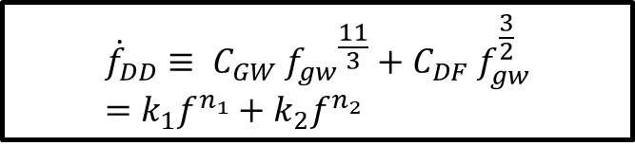
New Grid in k-Space for DD Effect
Brief Motivation
Key Eqns & Insight
Standard GFH grid assumes;
$\dot{f}=−kf^{n}$
DD modifies the $\dot{f}$;
Requires a different grid in k-space to follow this evolution.
Original grid :- $dk≈−nk\frac{δf}{f_{0,max}}$
New grid:-
  ${dk}_{2}≈−\frac{δf}{f_{0,max}}\left(n_{2}k_{2}+n_{1}k_{1}f^{n_{1}−n_{2}}\right)$
  ${dk}_{1}≈−\frac{δf}{f_{0,max}}\left(n_{1}k_{1}+n_{2}k_{2}f^{n_{2}−n_{1}}\right)$
Grid depends on $n,k_{1} \& k_{2}$.
Allows tracking power-law combination in GFH.
Enables search for DM$−$affected CW signals.
$${\dot{f}}_{DD}≡ C_{GW} {f_{gw}}^{\frac{11}{3}}+C_{DF} f_{gw}^{\frac{3}{2}}=k_{1}f^{n_{1}}+k_{2}f^{n_{2}}$$
New in this work: Grid generalized for multi-term spin-down.
Sethi, C.K., Master’s Thesis, (2025).
Sethi, C. K . and ALM. In prep.

Slide 11
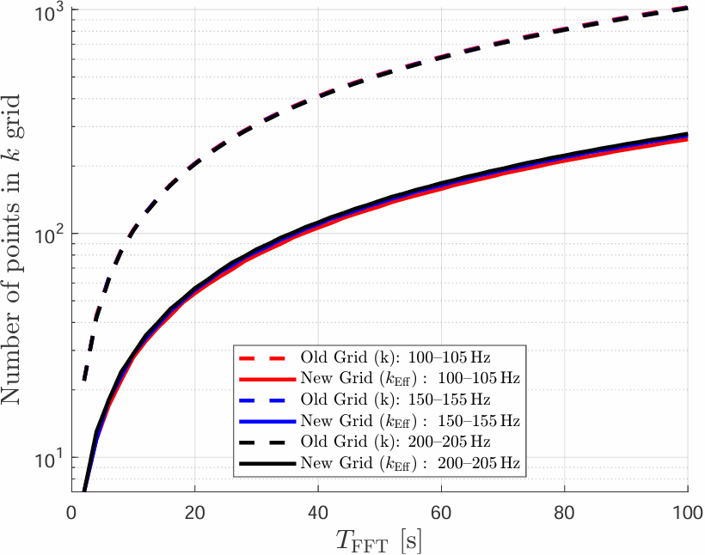
Number of points in the new grid is reduced compared to the original grid;
  Step-size increases in the new grid → fewer points needed
Advantage:
  Reduces search dimensionality
  Adapts grid spacing to physical signal structure
Behaviour of new grid v/s old grid.
Sethi, C. K . and ALM. In prep.

Slide 12


Results: Numerical Injection Strategy
Generate numerical
frequency evolution
Inject waveform
into Gaussian noise
Recover with
BinaryGFH-V2
Two numerical tests
1. Validation: numerical vacuum waveform
2. Application: dark-dressed waveform
$${\dot{f}}_{GW}=C_{GW} f^{11/3}$$
$${\dot{f}}_{DD}= C_{GW} f^{11/3}+ C_{DF} f^{3/2}$$
Purpose:
Full numerical evolution includes both GW and DF terms
Replace analytical injection with a numerical vacuum waveform
Test a DF-dominated regime using the n = 3/2 search
Check that the numerical injection/recovery pipeline works
Search with n = 11/3
Sethi, C. K . and ALM. In prep.
12

Slide 13
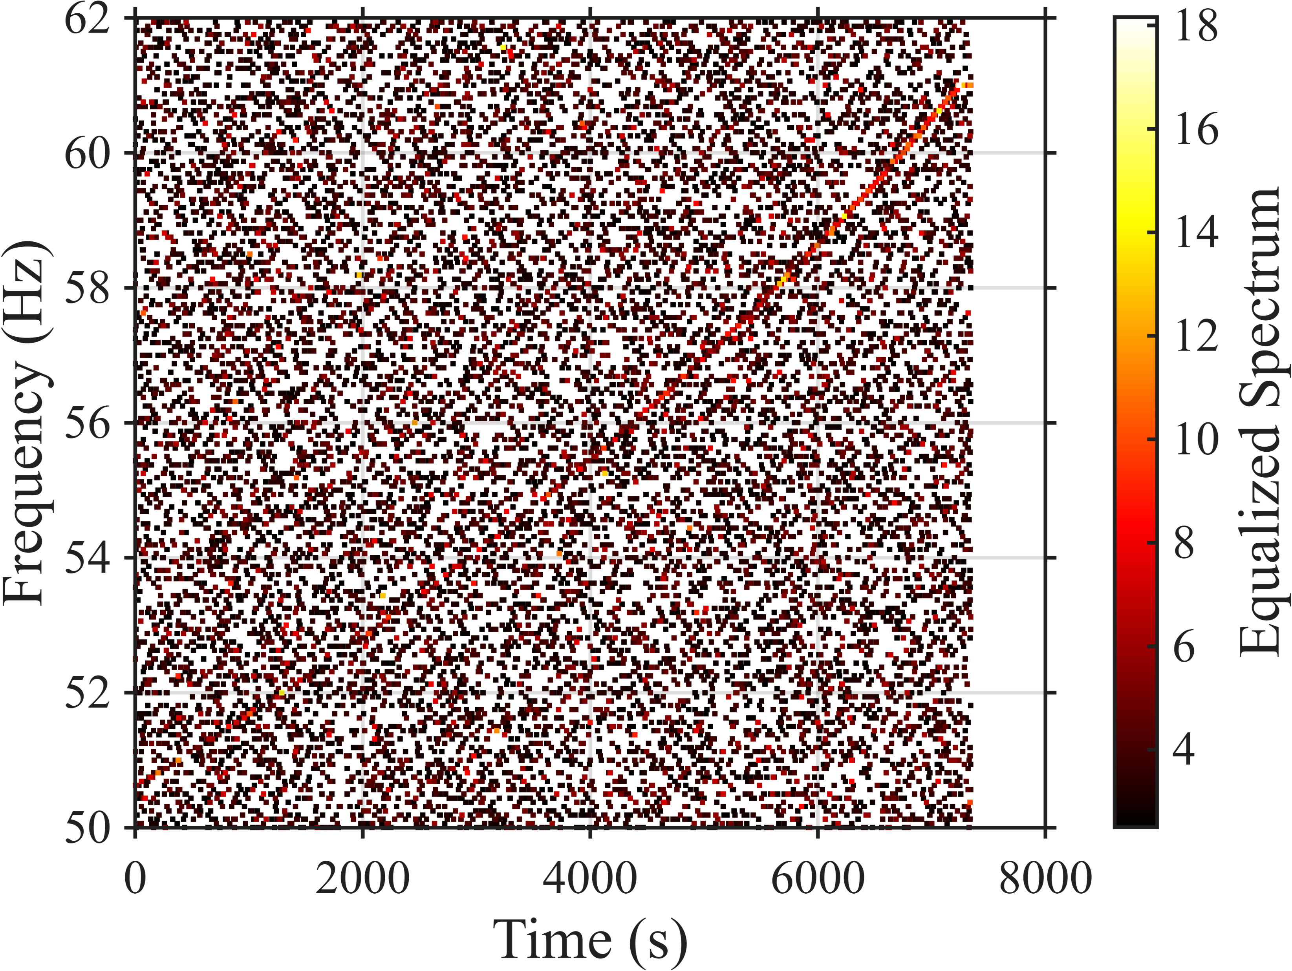
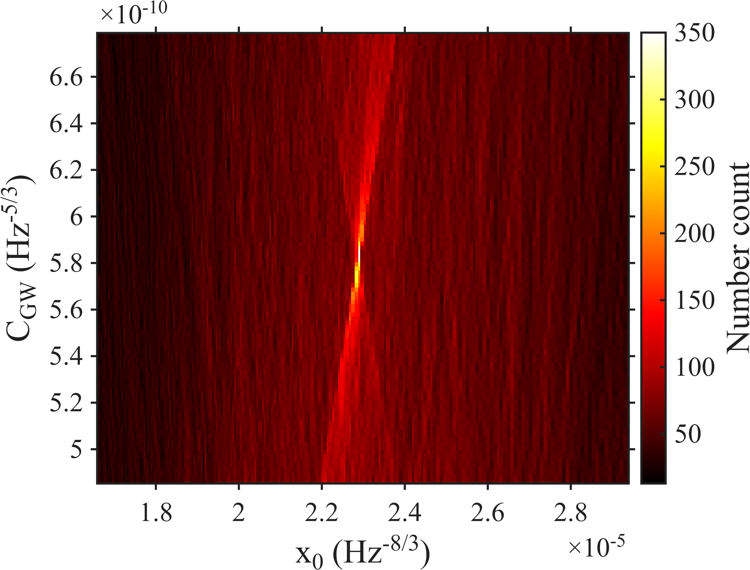
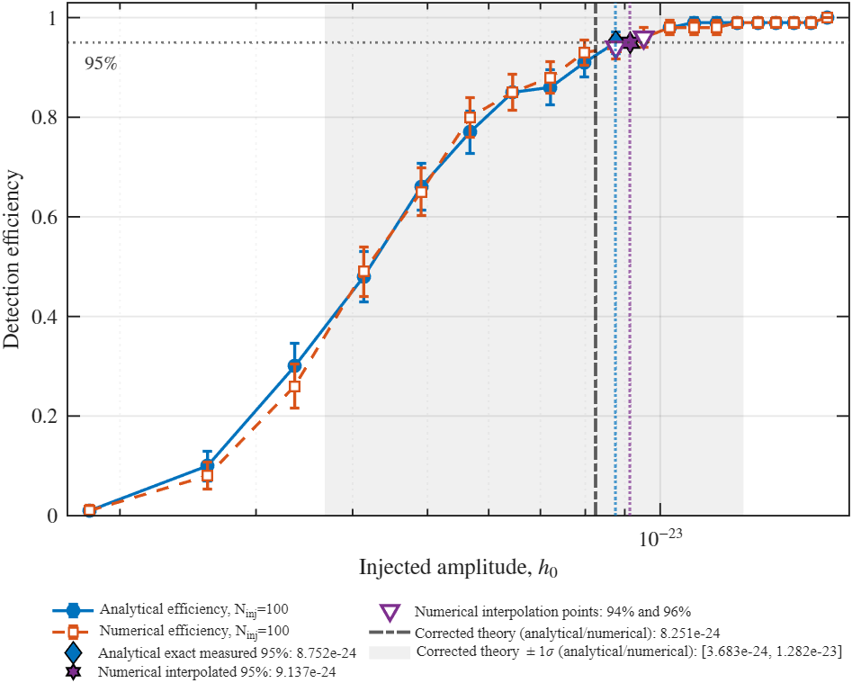
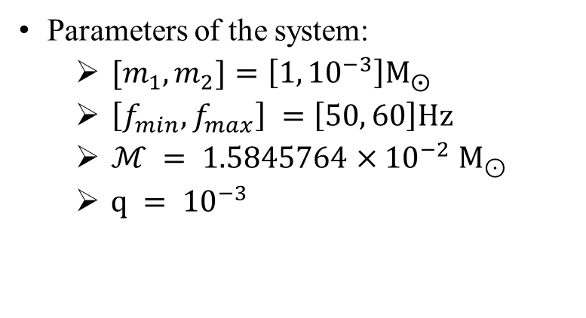

Validation: Numerical Vacuum Injection
Parameters of the system:
  $[m_{1}, m_{2}]=\left[1, {10}^{−3}\right]Μ_{⨀}$
  $\left[f_{min}, f_{max}\right] =\left[50, 60\right]Ηz$
  $ℳ = 1.5845764×{10}^{−2} M_{⊙}$
  $q = {10}^{−3}$
Peak-Map: created with $T_{FFT}=16 s$
Hough-Map: Output of the GFH (n=11/3)
Successfully recovered with BinaryGFH-V2 (n = 11/3)
Sethi, C. K . and ALM. In prep.

Slide 14
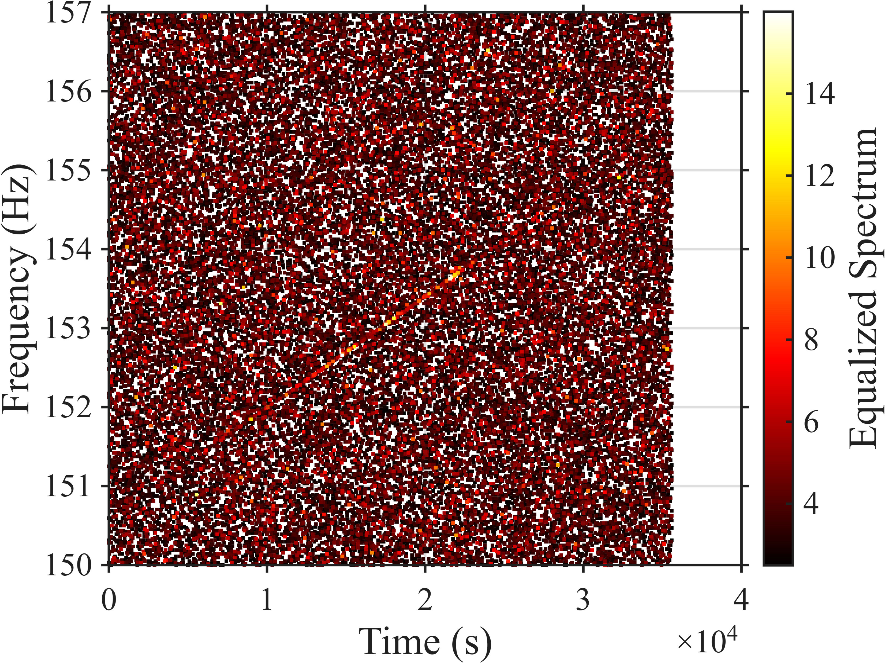
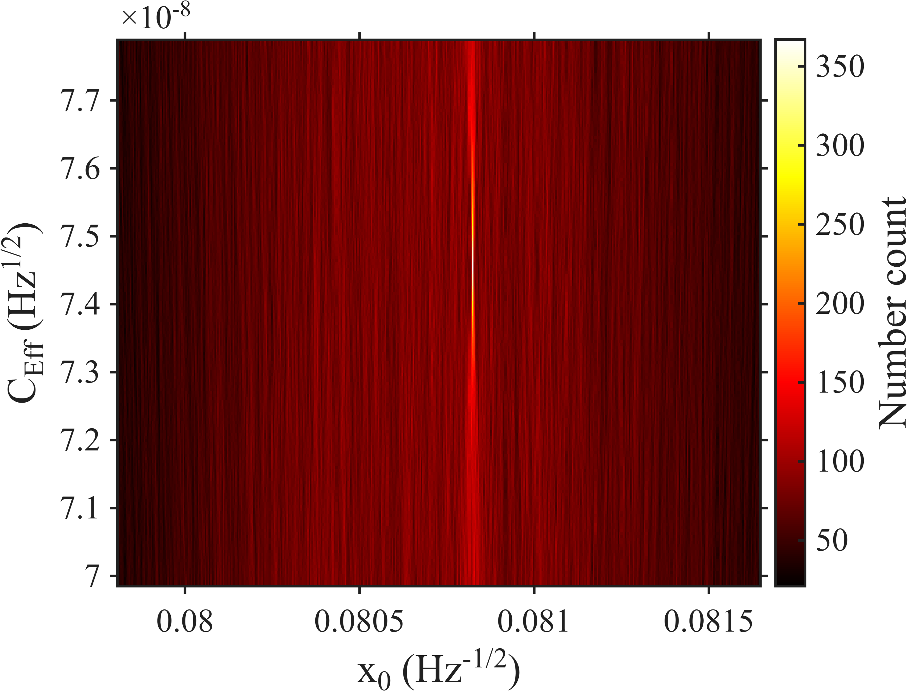
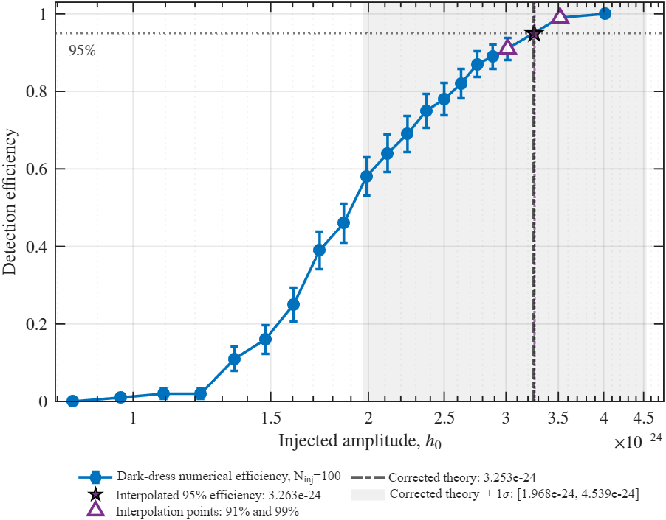

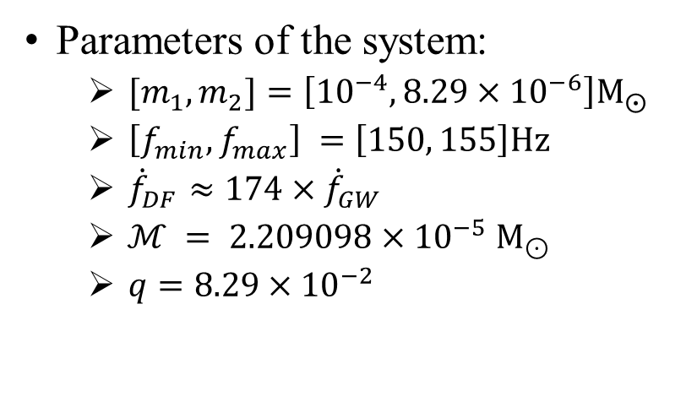
Dark-Dressed Numerical Injection: DF-Dominated Regime
Parameters of the system:
  $[m_{1}, m_{2}]=\left[{10}^{−4}, {8.29×10}^{−6}\right]Μ_{⨀}$
  $\left[f_{min}, f_{max}\right] =\left[150, 155\right]Ηz$
  ${\dot{f}}_{DF}≈174×{\dot{f}}_{GW}$
  $ℳ = 2.209098×{10}^{−5} M_{⊙}$
  $q={8.29×10}^{−2}$
Peak-Map: created with $T_{FFT}=64s$.
Hough-Map: Output of the GFH (n=3/2)
Successfully recovered with BinaryGFH-V2 (n = 3/2)
Sethi, C. K . and ALM. In prep.

Slide 15
Summary and Outlook
BinaryGFH-V2 is a powerful tool for detecting DD-PBH inspirals.
Run injections to assess the GFH sensitivity & compare it to theoretical predictions.
Method paper in preparation.
Application to Real GW Data:
  Extend to real detector noise (LIGO, Virgo, LISA).
  Focus on low-frequency signals (< 50Hz), key for DD PBH searches.
  Planning to do a search on open data for DD-Inspirals.
Dynamical Dark-Dress
Incorporating Additional Inspiral Effects:
  Include BH spin, tidal effects, and other DM interactions to refine waveform models.

Slide 16
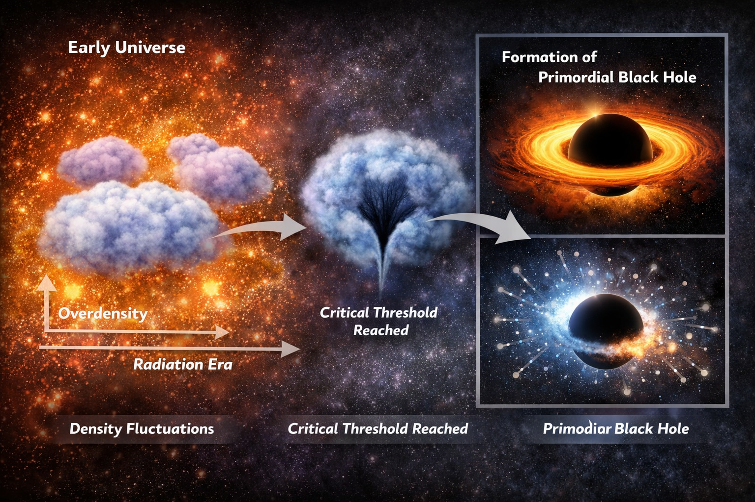
THANK YOU!

