Slide 1

Self-Interacting and Multifield
Fuzzy Dark Matter
Yu-Ming Yang (杨玉明)
yangyuming@ihep.ac.cn
Xiao-Jun Bi (毕效军）、Peng-Fei Yin (殷鹏飞）
State Key Laboratory of Particle Astrophysics,
Institute of High Energy Physics, CAS
2nd New Horizons for Psi Workshop
2026.08.24 @ Beijing
Notes:
Hello everyone. It’s my great pleasure to be here and share our recent work with you. The topic of my talk is Self-Interacting and Multifield Fuzzy Dark Matter.

Slide 2
Outline
Motivation
Self-Interacting Fuzzy Dark Matter
Multifield Fuzzy Dark Matter
Summary
Notes:
This is the outline of my talk.

Slide 3
Outline
Motivation
Self-Interacting Fuzzy Dark Matter
Multifield Fuzzy Dark Matter
Summary
Notes:
First, I’ll introduce the motivation of our study.

Slide 4
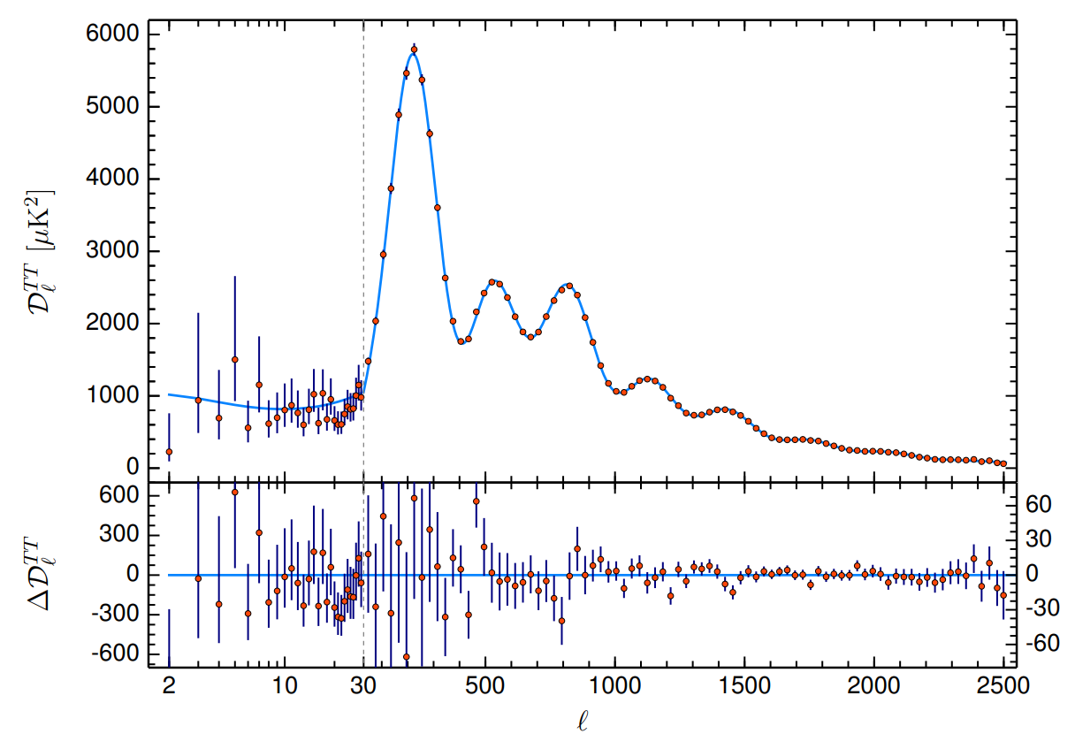
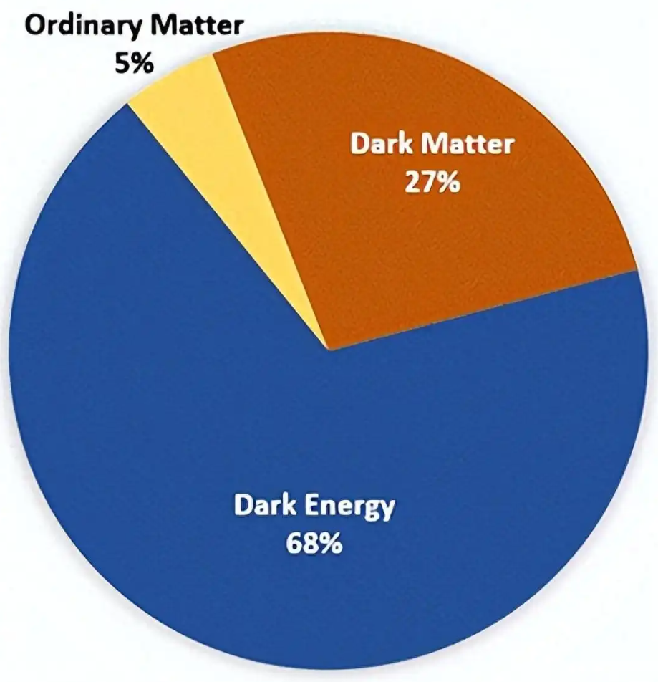
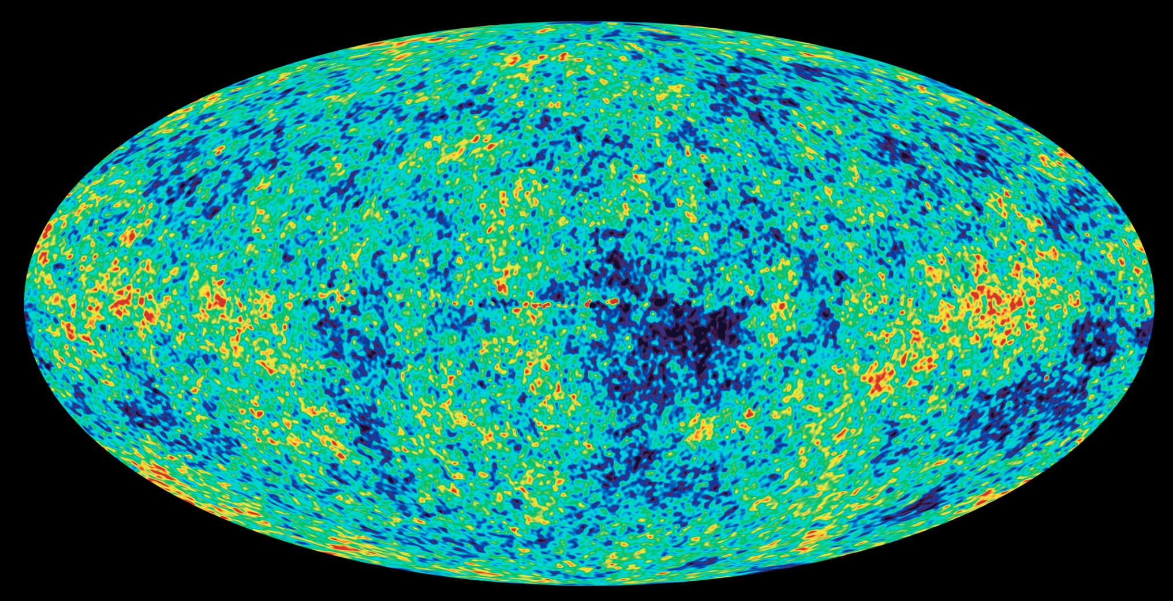
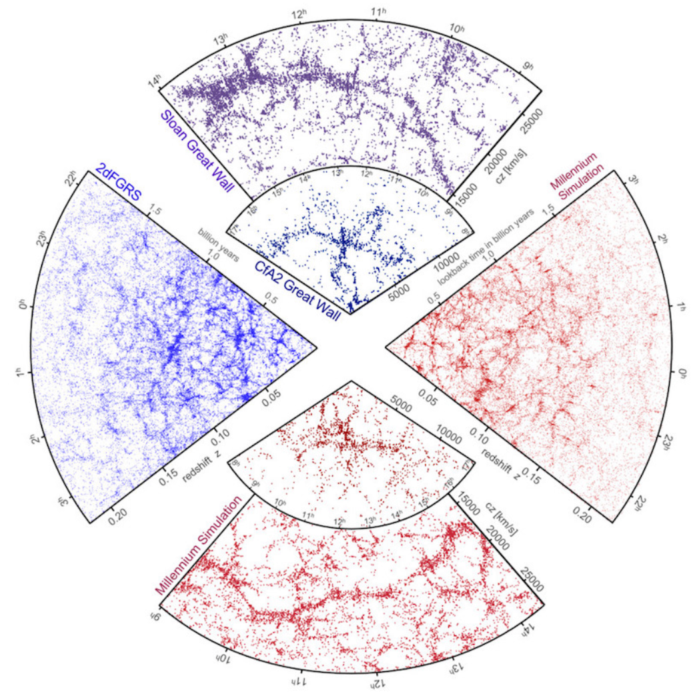
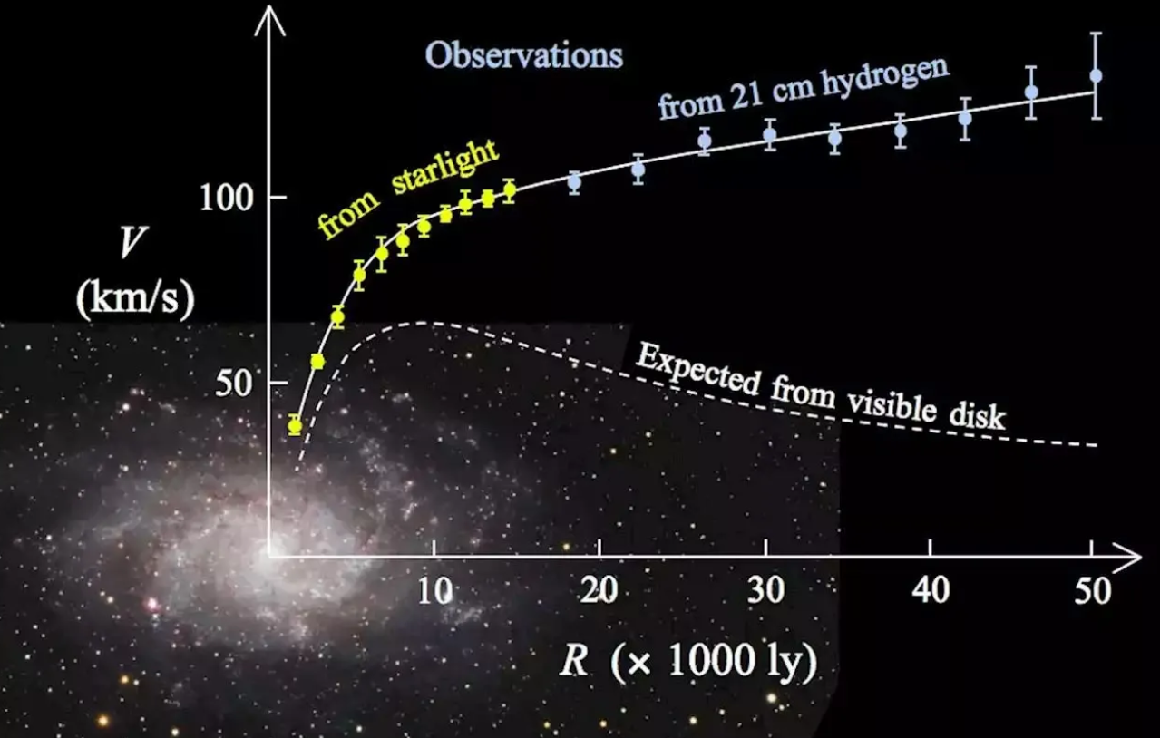
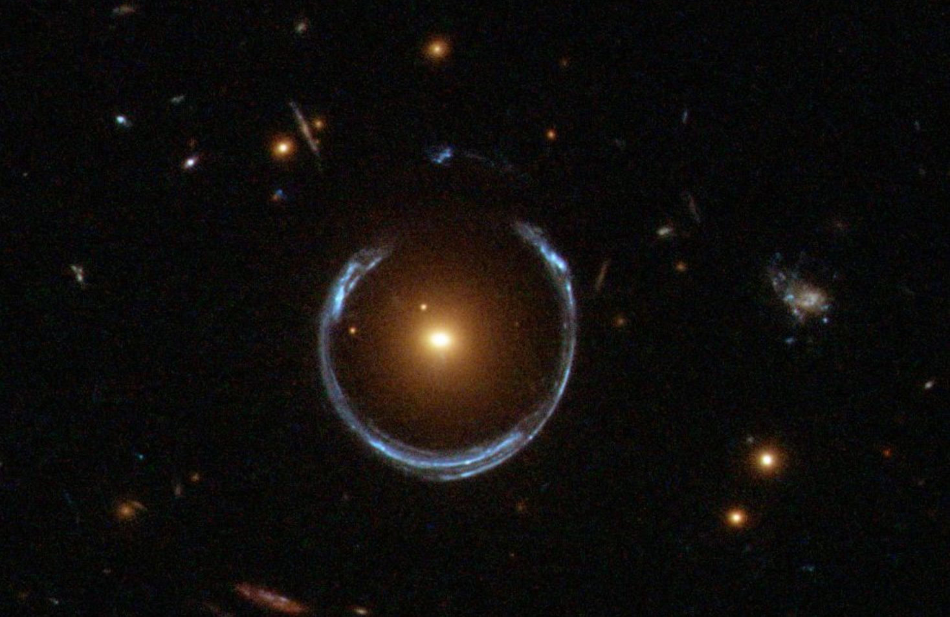
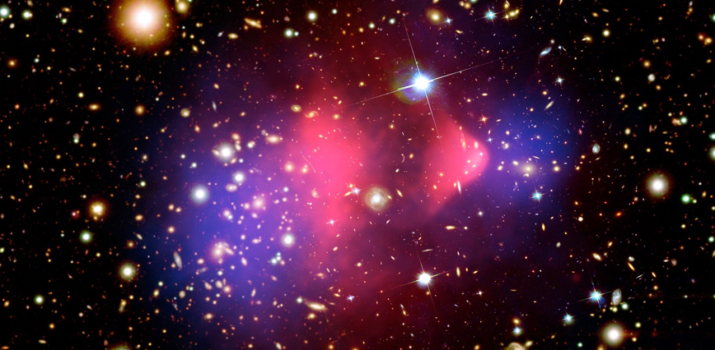
Motivation
ΛCDM model
CMB
Planck 2018
Large-scale structure
Bullet cluster
Galaxy rotation curve
Gravitational lensing
Notes:
As we all know, in the cosmological standard model, the Lambda-CDM model, dark matter is described as non-relativistic, collisionless particles. In the past decades, this model has made great achivements in explaining many observational aspects of our universe. For example, it can well explain th cosmological microwave background radiation, the largt-scale structure of our universe, the Bullet cluster, the Galactic rotation curves, and gravitational lensing.

Slide 5
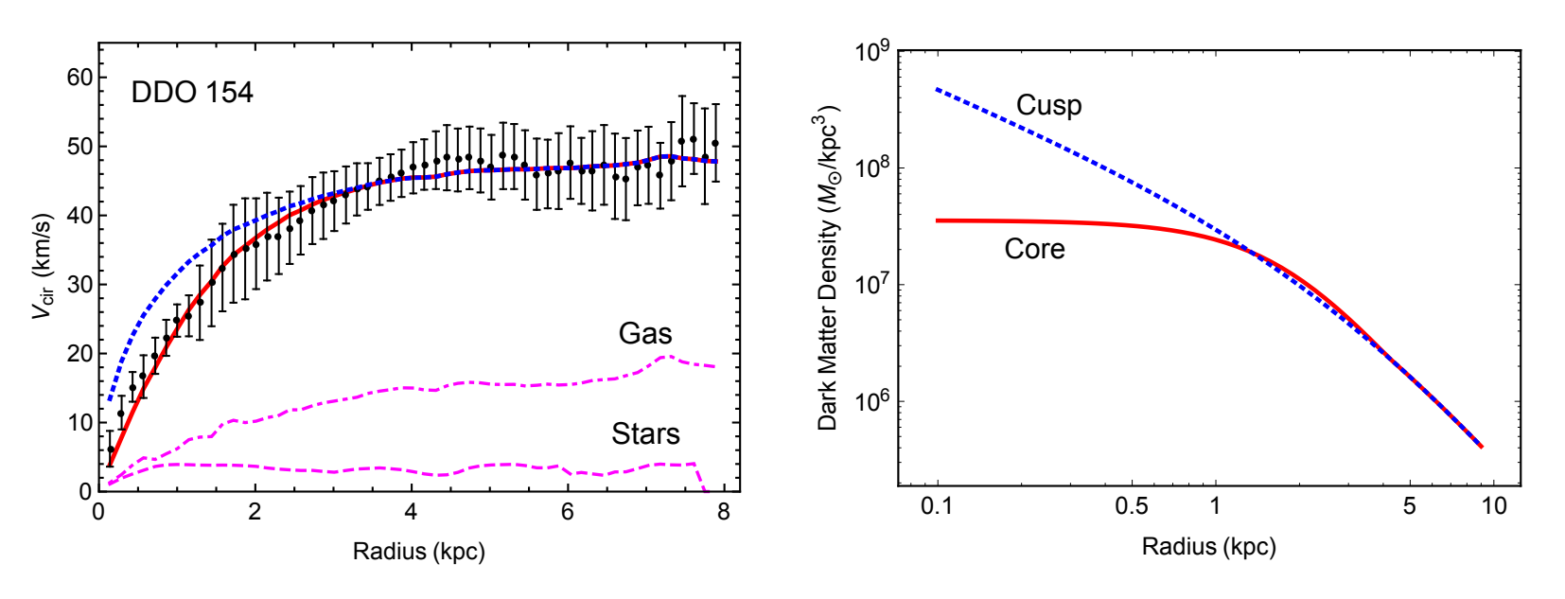
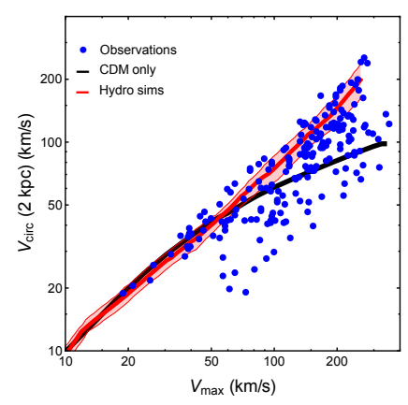
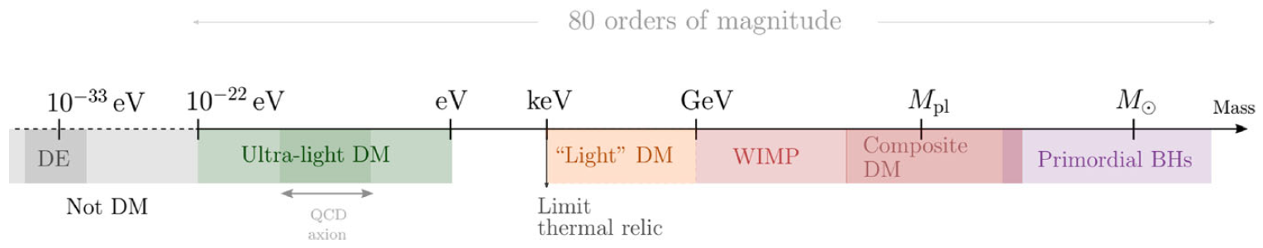

Motivation
Core-cusp problem
Diversity problem
Tulin & Yu. Physics Reports 730 (2018)
Too-big-to-fail problem
dark matter deficient galaxy
……
N-body simulation
Observation
Hu, Rennan, and Gruzinov. PRL. 2000 Aug 7;85(6):1158.
Fuzzy Dark Matter
de Broglie wavelength
Wave-like!
E.G.M. Ferreira, Astron Astrophys Rev 29, 7 (2021).
Notes:
However, with the development of the observational thechnologices, many small scale crisis of the cold dark matter model were recently revealed. For example, the Core-cusp problem, which said that in some dwarf galaxies, the dark matter density profile derived from the rotation curve, as shown by the red line in this figure, or some other stellar kinematic observations, has a core structure. However, the N-body simulation told us that the density profile of a cold dark matter halo is a NFW profile, which is cuspy in the central region. There are also many other problems, such as the diversity problem, too-big-to fail problem, and the existence of the dark matter deficient galaxies, and so on. On the one hand, these issues may be partially explained by complex baryonic physics such as star formation or AGN feedback; on the other hand, they may indicate that the nature of dark matter deviates from that of CDM in small scales. A fascinating alternative to CDM that has attracted considerable attention in recent years is fuzzy dark matter. This kind of dark matter is composed of ultralight bosonic particles with mass around ten to the minus twenty-two eV. At the typical velocity of galaxies, its de Broglie wavelength can reach kiloparsec scale. Therefore, the behavior of fuzzy dark matter will deviates from CDM at the typical scale of dwarf galaxies, this will help to address these small scale problems. On the large scale which is much larger than its de Broglie wavelength, it is indistinguishable from CDM, thereby preserving the success of CDM in explaining large-scale observations.

Slide 6

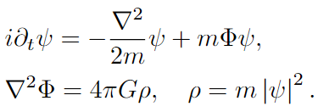

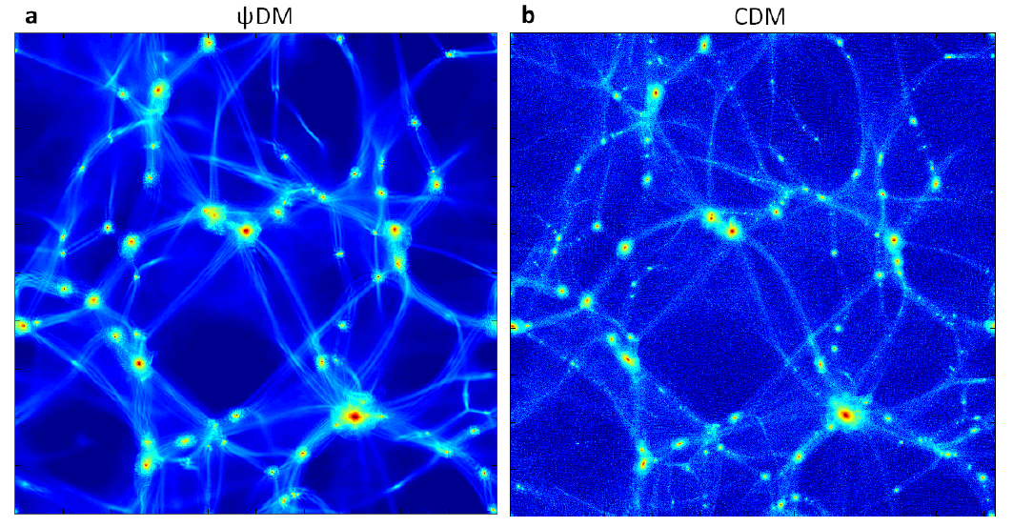
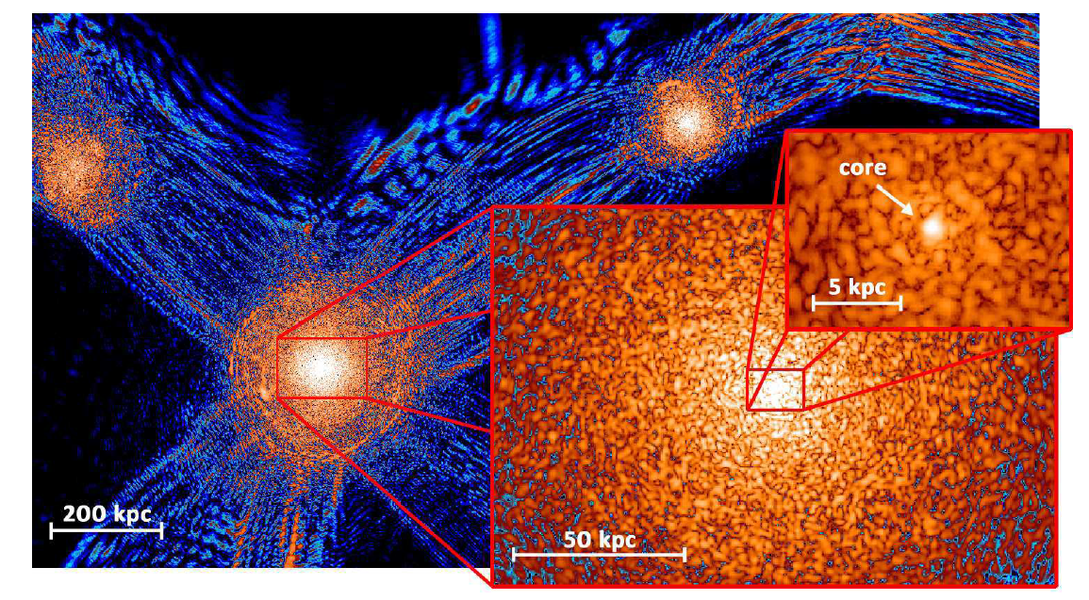
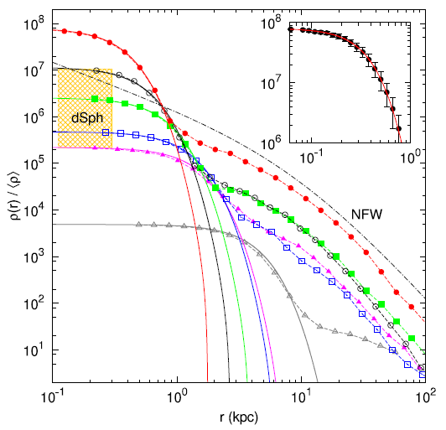


Motivation
Equation of motion
non-relativistic limit
Schrödinger-Poisson (SP) equations
Klein-Gordon equation
Cosmological simulation
FDM halo structure
Core-cusp problem
Schive et al. Nature Phys 10, 496–499 (2014).
Groundstate,
Bose-Einstein condensation
Notes:
As a scalar field, the equation of motion of fuzzy dark matter is a Klein-Gordon equation. In the non-relativistic limit, it can be reduced to a Schrodinger equation and a Poisson equation. The fuzzy dark matter is described by a complex wave fucntion psi. And the capital Phi in this equation represents the gravitational potential, the m is the particle mass of fuzzy dark matter.
This figure shows a cosmological simulation of fuzzy dark matter, which was completed in twenty fourteen. In this figure, the left and right panels represent the large-scale structure produced by fuzzy dark matter and cold dark matter simulations with the same initial condition, respectively. It can be seen there is no obvious differences between them. However, if we zoom-in to a single halo, it can be seen there is many fluactuations in the fuzzy dark matter density distribution, this is a consequence of interference. And in the central region of a fuzzy dark matter halo, due to the existence of quantum pressure, a solitonic core structure will form, this core structure is helpful to solve th core-cusp problem.

Slide 7
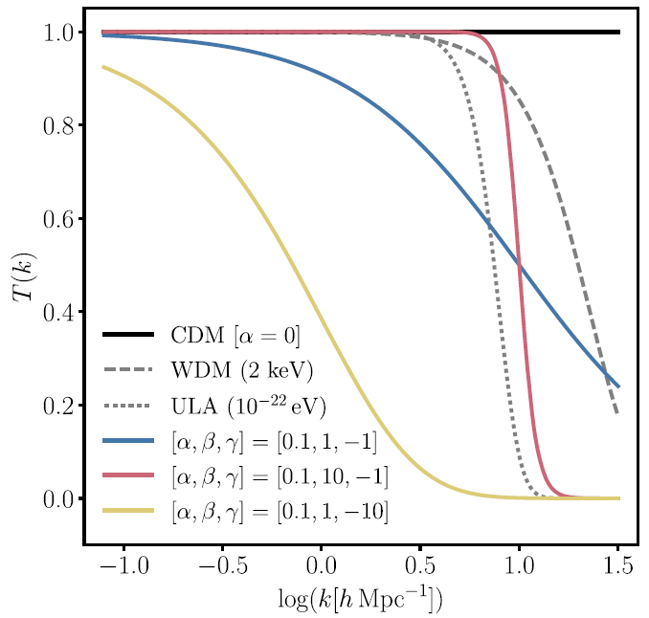
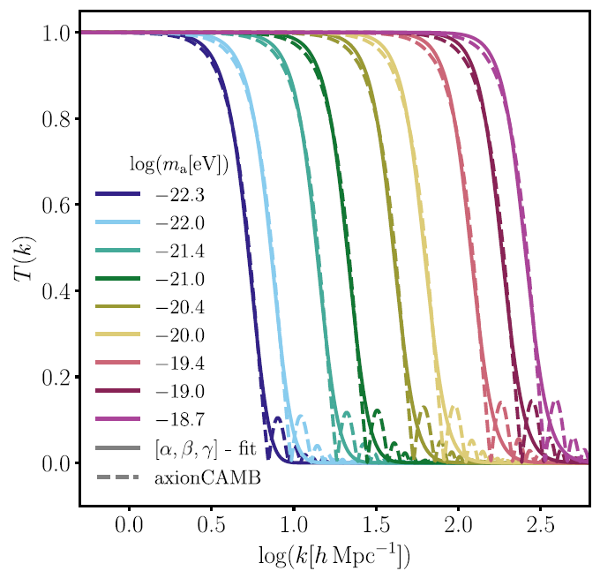
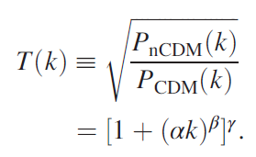






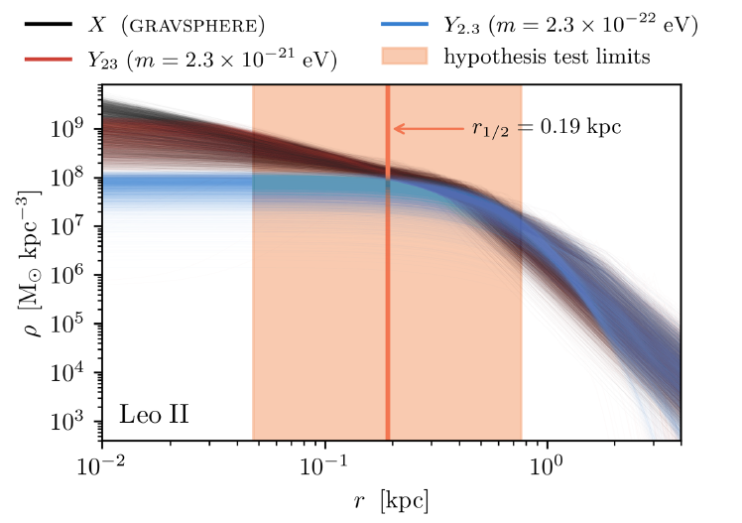
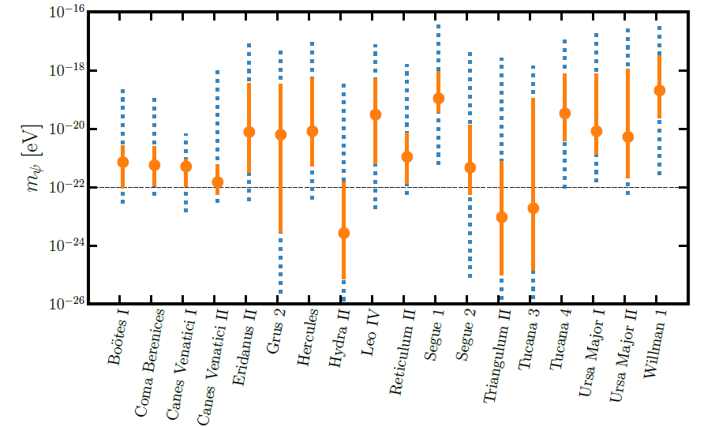



Motivation
Lyman-alpha forest
Phys. Rev. Lett. 126, 071302
Dynamical heating
Nuclear star cluster in Eridanus II (13pc)
Segue 1 (24.2pc) & Segue 2 (40.5pc)
Fornax (0.668kpc), Carina (0.24kpc), Leo II (0.21kpc), Leo I (0.25kpc), and Draco (0.22kpc)
Excluded
High-redshift UV luminosity function
T. Zimmermann et al., Phys. Rev. Lett. 134, 151001 (2025).
Jeans analysis
Subhalo mass function
Kohei Hayashi et al 2021 ApJL 912 L3
Superradiance
Excluded
Notes:
However, many strong constraints on the particle mass of fuzzy dark matter have emerged in recent years. These include constraints from the Lyman-alpha forest, the high-redshift UV luminosity function, the subhalo mass function, and superradiance. Moreover, observations of dwarf galaxies have also placed stringent constraints on the FDM particle mass.
One important constraint comes from dynamical heating. In FDM halos, soliton oscillations, random walks, and granule fluctuations lead to fluctuations in the gravitational potential. These fluctuations can transfer kinetic energy to the stars, causing the stellar system to expand and its velocity dispersion to increase. If the heating is too strong, the resulting stellar system would be inconsistent with observations, which can place a lower bound on the FDM particle mass.
Some other constraints come from Jeans analysis. A recent study obtained a strong constraint using observations of the dwarf galaxy Leo II. Specifically, they used the observed stellar velocities in Leo II and performed a Jeans analysis to infer the allowed range of the dark matter density profile, shown by the black lines here. Then they reconstructed the density profile for different FDM particle masses. For sufficiently small particle masses, the soliton becomes too extended, and its central density profile becomes inconsistent with the Jeans constraints. These low-mass models are therefore ruled out, as shown here.The first study I’ll introduce also focuses on the Leo II system.
It is not difficult to understand why fuzzy dark matter is subject to so many constraints, because it has only one free parameter, the particle mass.

Slide 8
Outline
Motivation
Self-Interacting Fuzzy Dark Matter
Multifield Fuzzy Dark Matter
Summary
Notes:
This naturally motivates us to extend the model. Two natural possibilities are to introduce self-interactions and to consider multiple fields with different masses.

Slide 9

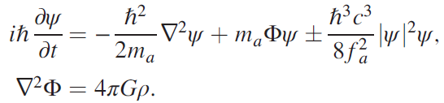



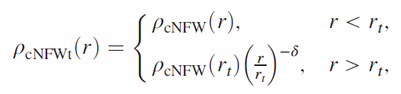


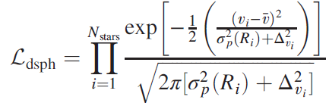
Self-Interacting Fuzzy Dark Matter
Gross-Pitaevskii-Poisson (GPP) equation
Attractive SI
Smaller Core
Revisit the constraint from Leo II
Y. Zhao, Y.M. Yang, X.J. Bi, and P.F. Yin, Phys. Rev. D 114, 023043
Jeans Eq:
Likelihood:
CoreNFWt:
Free parameters:
Notes:
To introduce self-interactions, we can simply add a self-interaction term to the Lagrangian, for example, the commonly used phi-four term. This introduces an additional self-interaction potential in the equation of motion for the psi field, where the two signs correspond to repulsive and attractive interactions. As one might expect, an attractive interaction makes the central soliton more compact, potentially alleviating the Leo II constraint discussed earlier.
Therefore, we revisited the Jeans analysis of Leo II. The basic idea is to use the Jeans equation, together with the observed stellar distribution and velocity information, to infer the underlying dark matter distribution. We assume a parameterized dark matter profile, construct a likelihood function, and use MCMC sampling to obtain the posterior distributions of the model parameters.

Slide 10
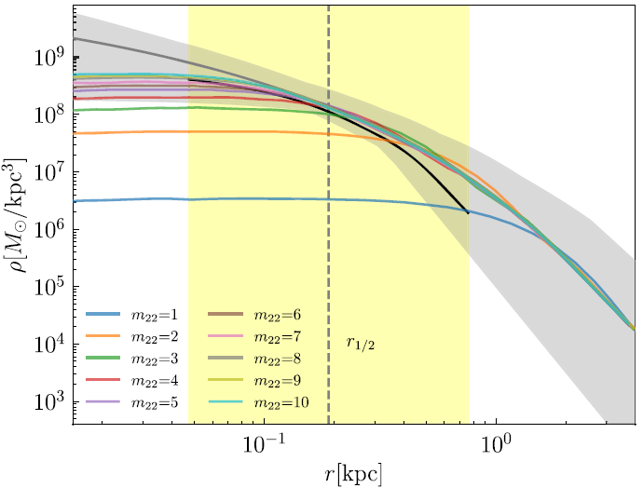


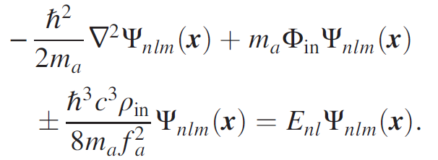
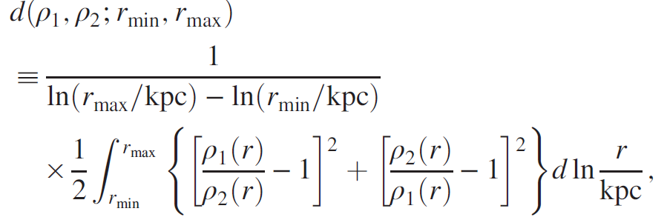
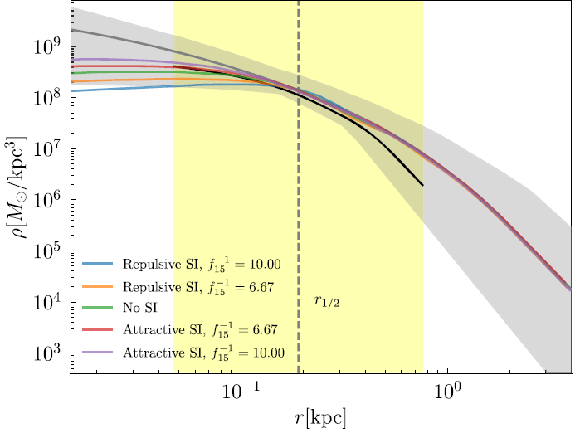
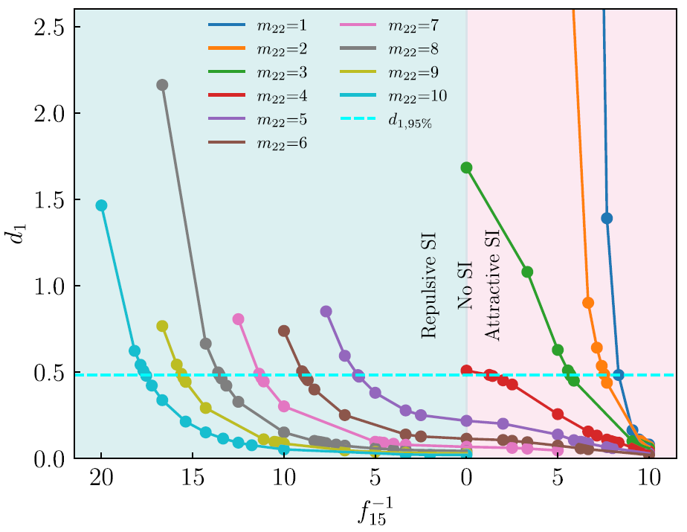
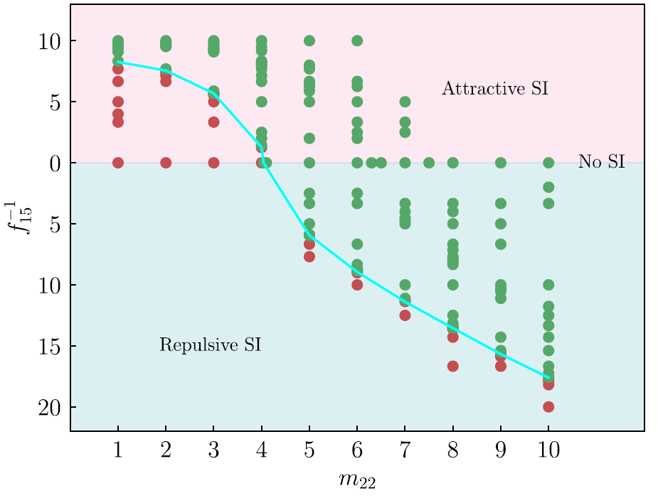

Self-Interacting Fuzzy Dark Matter
Result of MCMC sampling:
Reproduce the density profile via eigenstate decomposation:
Statistic:
Notes:
The resulting allowed range of dark matter profiles are shown by the shaded regions in this figure. We then use the eigenstate decomposition method to reproduce the Jeans-inferred dark matter profile for different combinations of the interaction strength and particle mass. The upper panel shows the non-interacting case. As you can see, the discrepancy with the Jeans result becomes increasingly significant as the particle mass decreases. The lower panel shows the results for different interaction strengths at a fixed particle mass. We find that stronger repulsive interactions lead to poorer agreement, while stronger attractive interactions provide a better match to the Jeans result. By defining the statistic, we obtain the ninety-five percent confidence region in the parameter space. The region below this line is excluded.

Slide 11
Outline
Motivation
Self-Interacting Fuzzy Dark Matter
Multifield Fuzzy Dark Matter
Summary
Notes:
Another extension we considered is the multifield fuzzy dark matter mode,.

Slide 12
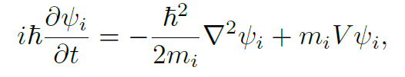
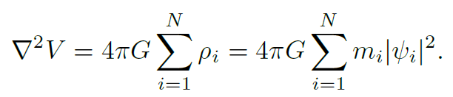

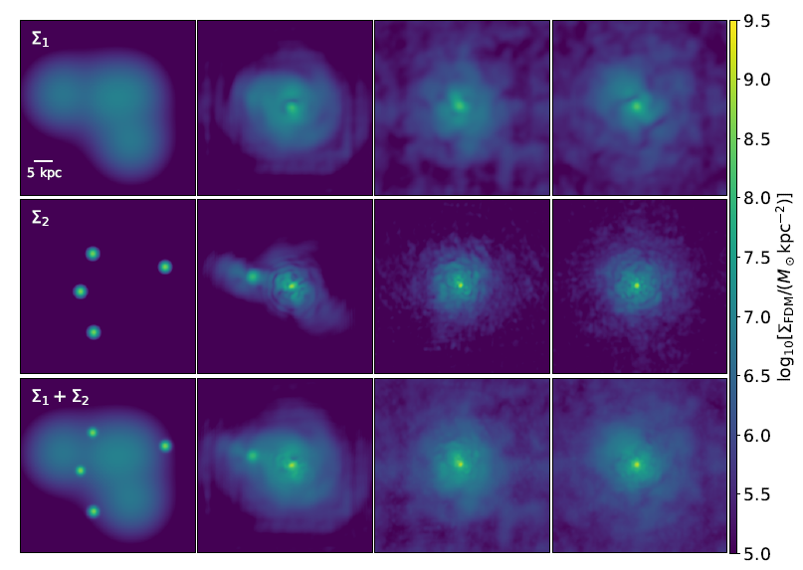


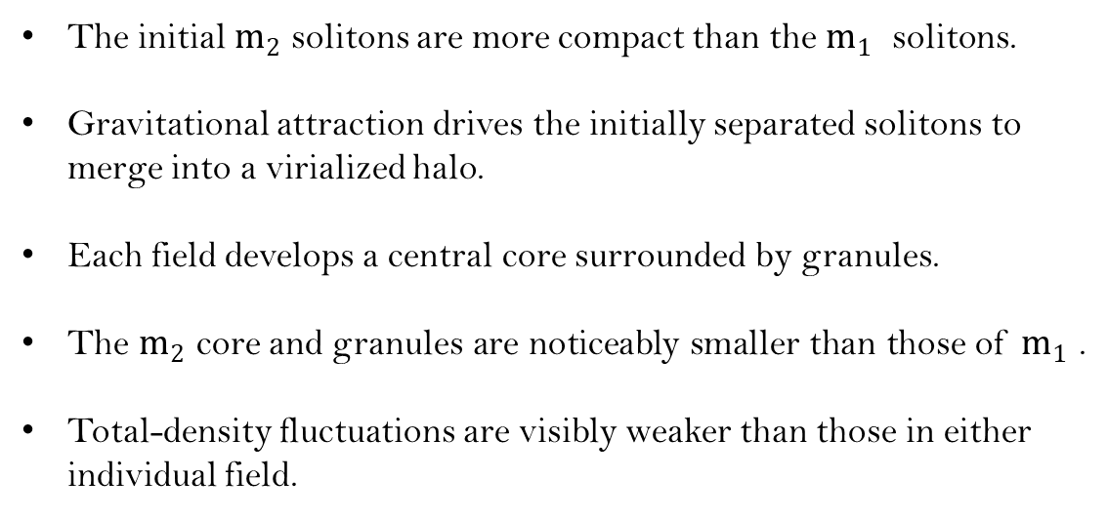
Multifield Fuzzy Dark Matter
Multifield coupled through gravity
Solitons merge
The initial $m_{2}$ solitons are more compact than the $m_{1}$ ​ solitons.
Gravitational attraction drives the initially separated solitons to merge into a virialized halo.
Each field develops a central core surrounded by granules.
The $m_{2}$ core and granules are noticeably smaller than those of $m_{1}$ .
Total-density fluctuations are visibly weaker than those in either individual field.
Notes:
In this model, we assume N fields that interact only through gravity. This figure shows the merger process of several initial solitons in a two-field model, driven by gravitational attraction. The two field components have particle masses of these two values, respectively. The three rows show the time evolution of the projected density for the first field, the second field, and the total density, respectively.
It can be seen that the initial solitons for m-two are more compact than that for m-one. And the gravitational attraction drives the initially separated solitons to merge into a virialized halo, with each field develops a central core surrounded by granules. In the virialize halo, the size of the core and granules for m-two are noticeably smaller than those of m-one. Morever, it can be seen that the total-density fluctuations are visibly weaker than those in either individual field, this is due to the superposition of two density fluctuations.

Slide 13
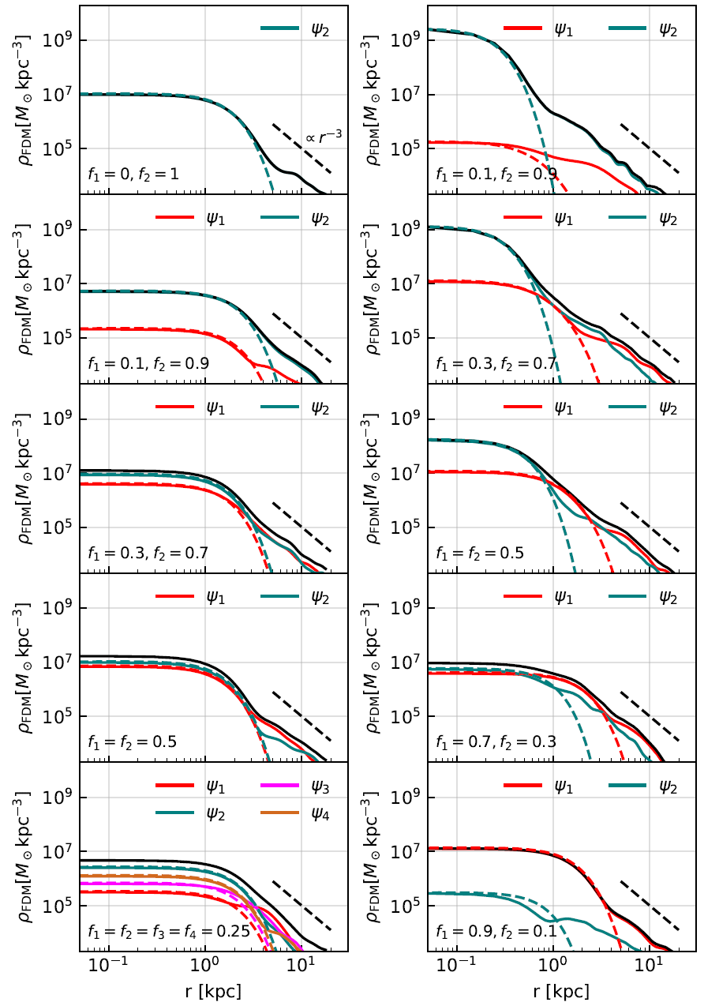
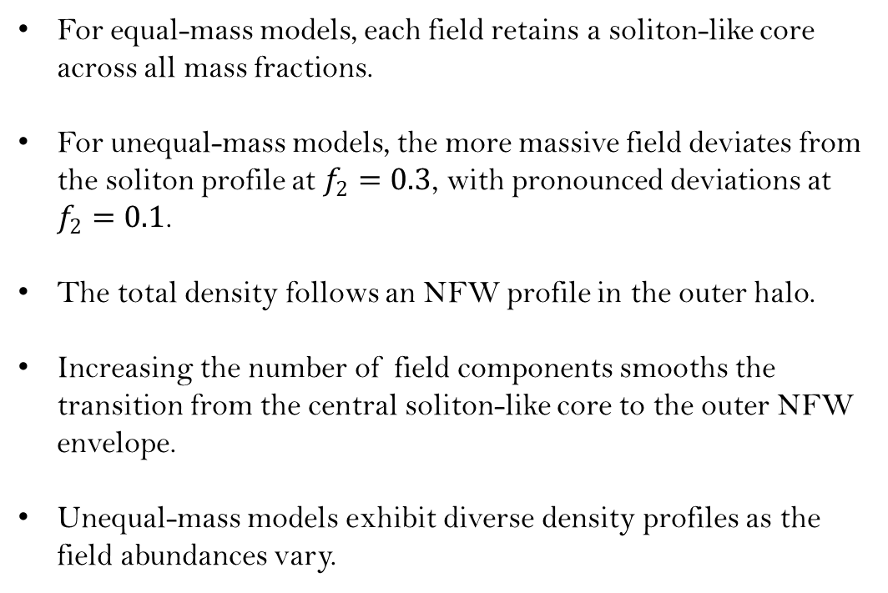
Multifield Fuzzy Dark Matter
Density profile
For equal-mass models, each field retains a soliton-like core across all mass fractions.
For unequal-mass models, the more massive field deviates from the soliton profile at $f_{2}=0.3$, with pronounced deviations at $f_{2}=0.1$.
The total density follows an NFW profile in the outer halo.
Increasing the number of field components smooths the transition from the central soliton-like core to the outer NFW envelope.
Unequal-mass models exhibit diverse density profiles as the field abundances vary.
Diversity problem?
Notes:
The density profiles of the resulting halos are shown in these two figures, corresponding to different values of the mass of the second field. Within each column, the different panels show different relative abundances of the two field components. It can be seen that for equal-mass models, each field retains a soliton-like core across all mass fractions. However, for unequal-mass models, the more massive field deviates from the soliton profile its abundances drops to thrity percent, and with pronounced deviations when drops to ten percent. This indicates that the more massive field cannot form a soliton when its mass fraction is too small. In the outer halo, the total density follows a NFW-like profile, and increasing the number of field components smooths the transition from the central soliton-like core to the outer NFW envelope. Most importantly, unequal-mass models exhibit diverse density profiles as the field abundances vary. This maybe helpful to address the diversity problem.

Slide 14
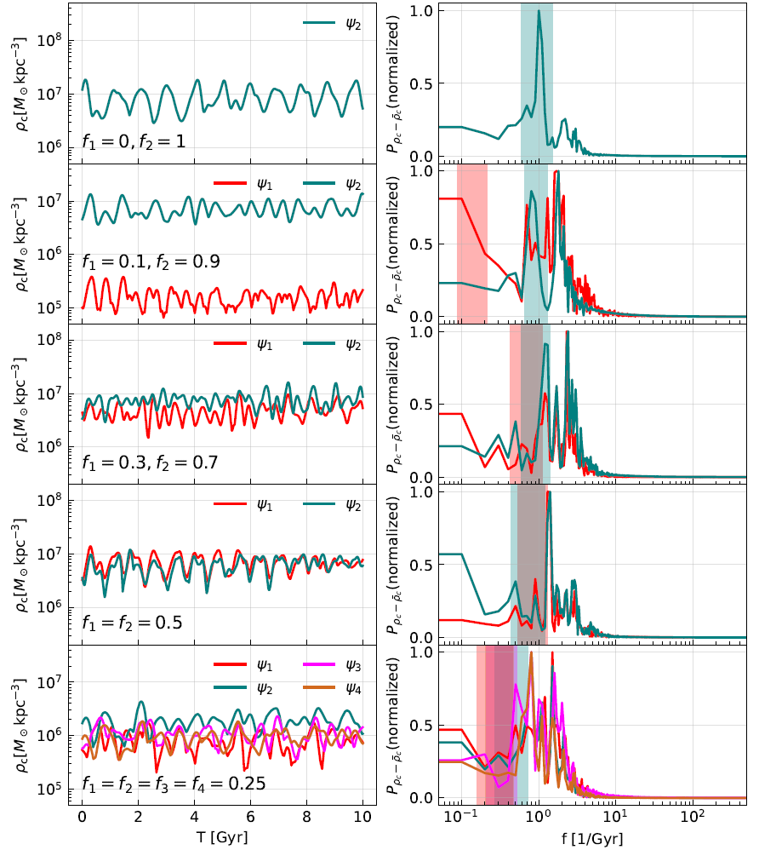
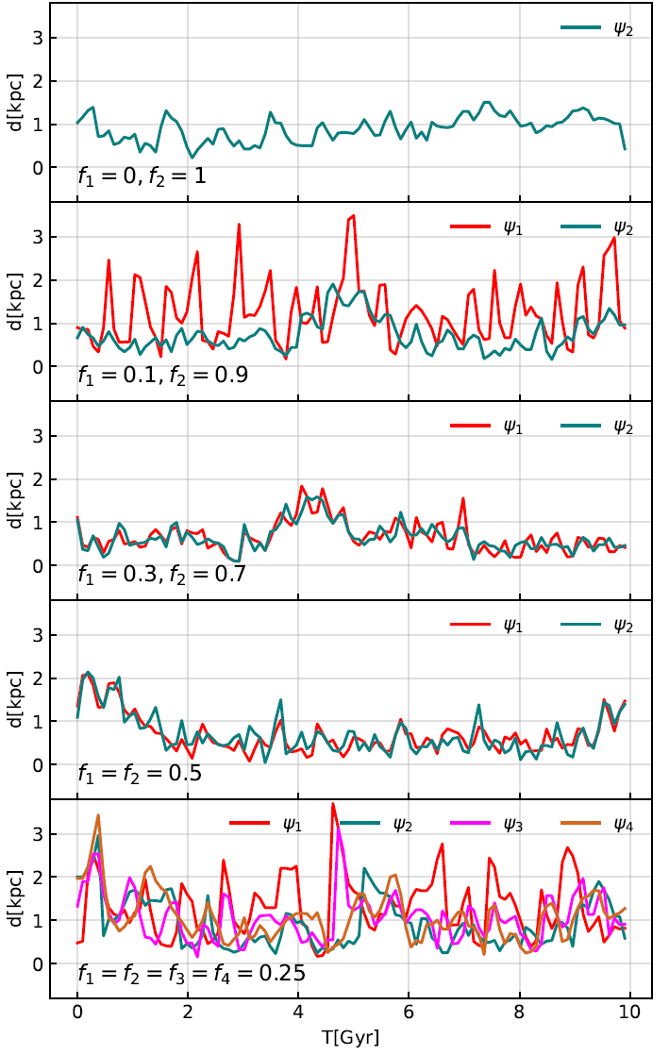
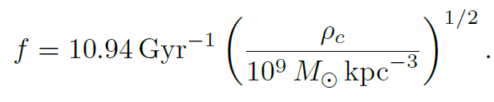
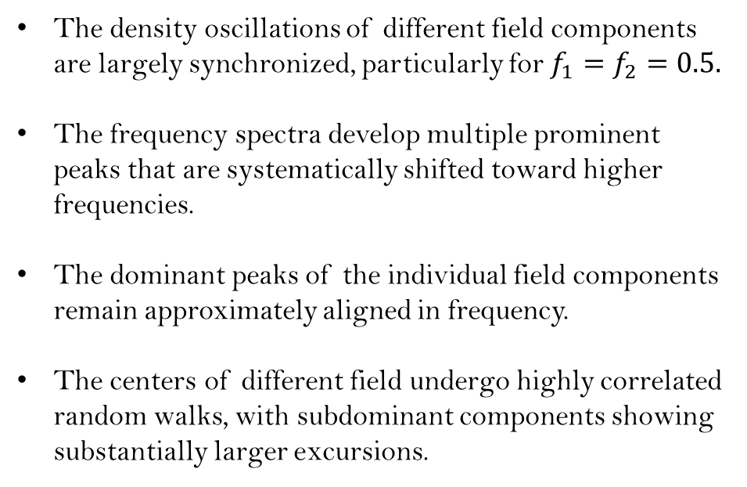
Multifield Fuzzy Dark Matter
Soliton oscillation
Soliton random walk
The characteristic oscillation frequency of a single-field FDM soliton
The density oscillations of different field components are largely synchronized, particularly for $f_{1}=f_{2}=0.5.$
The frequency spectra develop multiple prominent peaks that are systematically shifted toward higher frequencies.
The dominant peaks of the individual field components remain approximately aligned in frequency.
The centers of different field undergo highly correlated random walks, with subdominant components showing substantially larger excursions.
Notes:
These two figures show the soliton oscillations and random walks, respectively. Soliton oscillation refers to the time evolution of the soliton core density. Previous studies have shown that, in the single-field case, the oscillation frequency can be estimated from this formula. As we can see from the frequency spectrum, the peak revealed by our simulation agrees well with the theoretical prediction for the single-field case. For the multifield case, the density oscillations of different field components are largely synchronized. And the frequency spectra develop multiple prominent peaks that are systematically shifted toward higher frequencies, with the dominant peaks of the individual field components remain approximately aligned. As for the soliton random walks, the centers of different field undergo highly correlated random walks, with subdominant components showing substantially larger excursions.

Slide 15
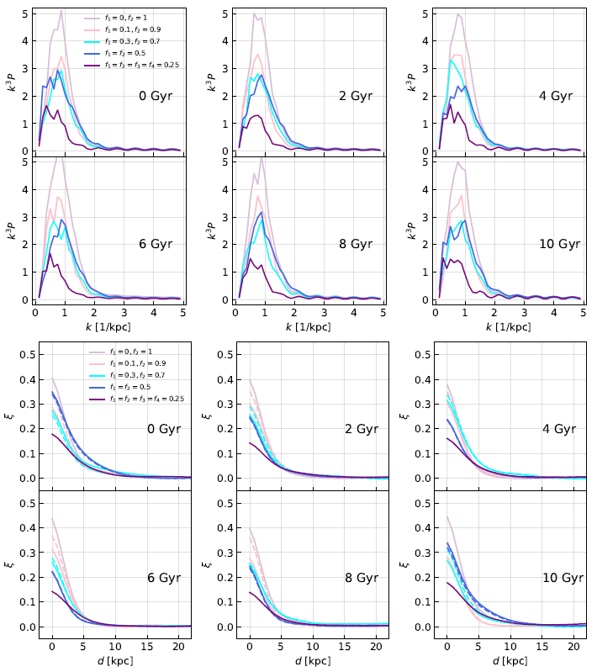





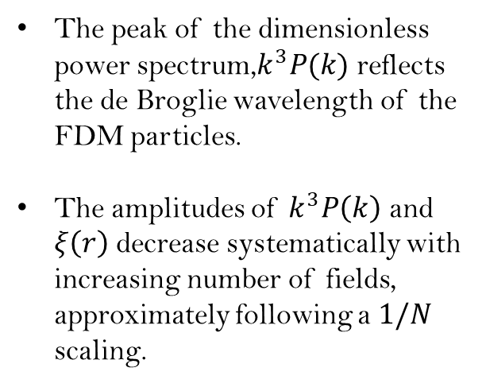
Multifield Fuzzy Dark Matter
Granular fluactuations
Density fluactuation
The peak of the dimensionless power spectrum,$k^{3}P(k)$ reflects the de Broglie wavelength of the FDM particles.
The amplitudes of $k^{3}P\left(k\right)$ and $ξ\left(r\right)$ decrease systematically with increasing number of fields, approximately following a $1/N$ scaling.
Power spectrum
Two-point correlation function
Notes:
We study the statistical properties of the granule fluctuations around the core using the fluctuation power spectrum and the two-point correlation function. In fact, these two quantities are simply Fourier transforms of each other. The peak of the dimensionless power spectrum reflects the de Broglie wavelength of the FDM particles. The most important feature in this figure is that the amolitudes of these two functions decrease systematically with increasing number of fields, approximately following a one over N scaling. This suggests that increasing the number of field components suppresses density fluctuations induced by granules, potentially reducing the resulting dynamical heating.

Slide 16
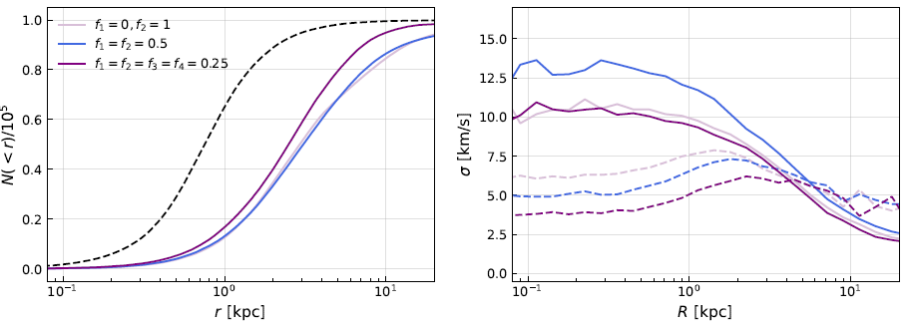
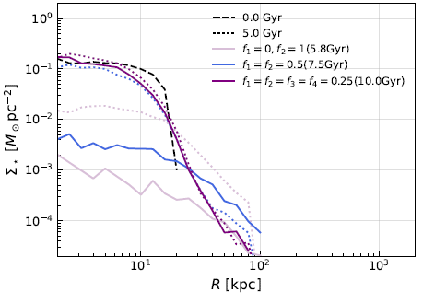
Multifield Fuzzy Dark Matter
Dynamical heating
Stellar system initially in equilibrium within a multifield FDM halo
The single- and two-field cases show very similar stellar distribution expansion, while the four-field case exhibits noticeably weaker expansion.
The velocity-dispersion profiles show no clear evidence for weaker dynamical heating with increasing number of field components.
Self-gravitating stellar system outside the core
In the single-field model, the stellar system is nearly disrupted by ∼5.8 Gyr.
In the two-field model, the stellar system is nearly disrupted by ∼7.5 Gyr.
The four-field model shows no clear sign of disruption over 10 Gyr.
Notes:
We investigate this effect by combining FDM fluctuation simulations with N-body simulations of the stellar particles. We consider two cases. In the first case, the stars are distributed throughout the halo and are initially in equilibrium with its gravitational potential. The left and right panels show the evolution of the stellar distribution and velocity dispersion, respectively. It can be seen that the single- and two-field cases show very similar stellar distribution expansion, while the four-field case exhibits noticeably weaker expansion. However, the velocity-dispersion profiles show no clear evidence for weaker dynamical heating with increasing number of field components. The reason is that, in this setup, both the soliton and granules contribute to the dynamical heating, while the decrease in fluctuations with increasing number of fields applies only to the granules. To isolate the contribution of granules to the dynamical heating, we consider a second setup in which a self-gravitating stellar system is artificially placed outside the core. As you can see, the stellar system is disrupted at around 5.8 Gyr in the single-field case and 7.5 Gyr in the two-field case, while it remains stable throughout the 10 Gyr evolution in the four-field case. This directly demonstrates that granule-induced dynamical heating becomes weaker as the number of field components increases.

Slide 17
Outline
Motivation
Self-Interacting Fuzzy Dark Matter
Multifield Fuzzy Dark Matter
Summary

Slide 18
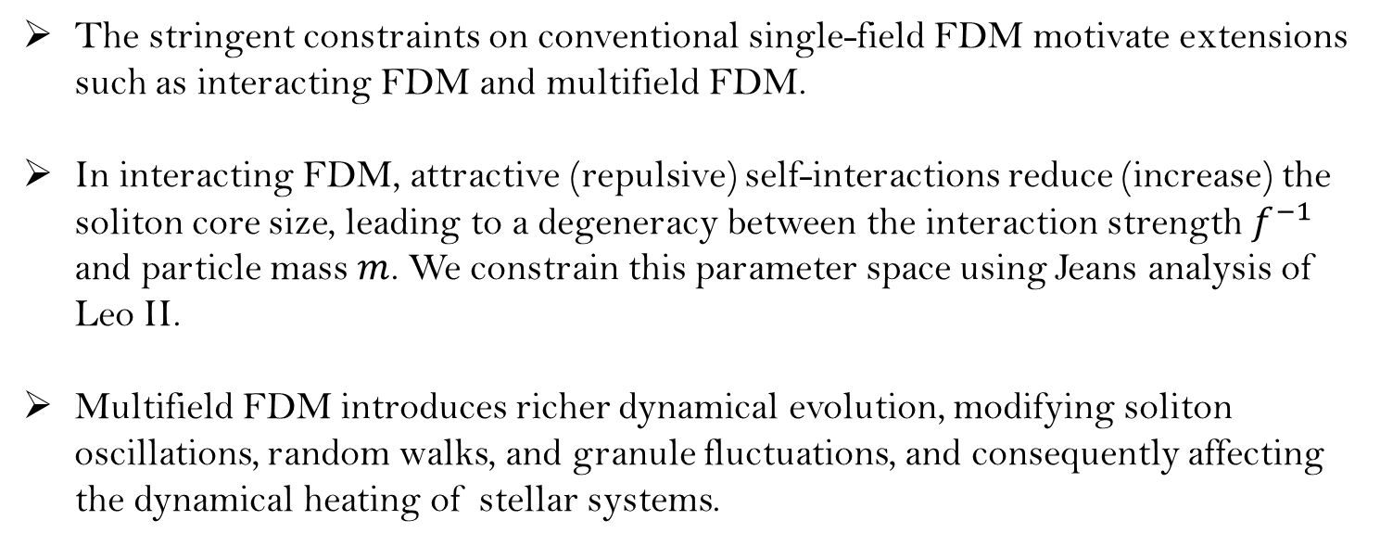
Summary
The stringent constraints on conventional single-field FDM motivate extensions such as interacting FDM and multifield FDM.
In interacting FDM, attractive (repulsive) self-interactions reduce (increase) the soliton core size, leading to a degeneracy between the interaction strength $f^{−1}$ and particle mass $m$. We constrain this parameter space using Jeans analysis of Leo II.
Multifield FDM introduces richer dynamical evolution, modifying soliton oscillations, random walks, and granule fluctuations, and consequently affecting the dynamical heating of stellar systems.
Thank you!
Notes:
So, this is the summary of my talk. That’s all for my talk. Thank you very much for your attention.

