Slide 1
Background-Induced Forces from Quadratically Coupled Ultralight Dark Matter
arxiv: 2606.28481
Presenter: Hailin Xu
Thomas Bouley³, Xucheng Gan², Hailin Xu¹, and Tien-Tien Yu²
¹Tsung-Dao Lee Institute, Shanghai Jiao Tong University, Shanghai, China
²Deutsches Elektronen-Synchrotron DESY, Hamburg, Germany
³University of Oregon, Eugene, USA

Slide 2
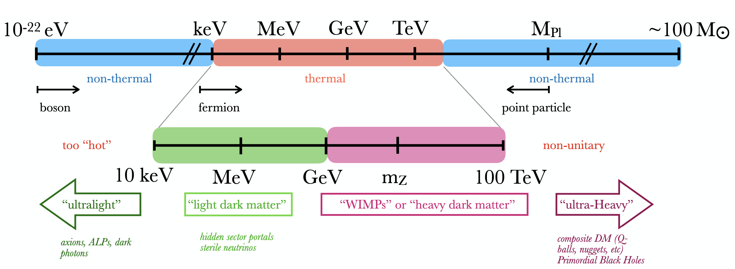
Ultralight Dark Matter
Below keV: bosonic DM only
We consider ultralight scalar DM, coupled to SM field constants that results in EP violation / fifth force phenos.

Slide 3

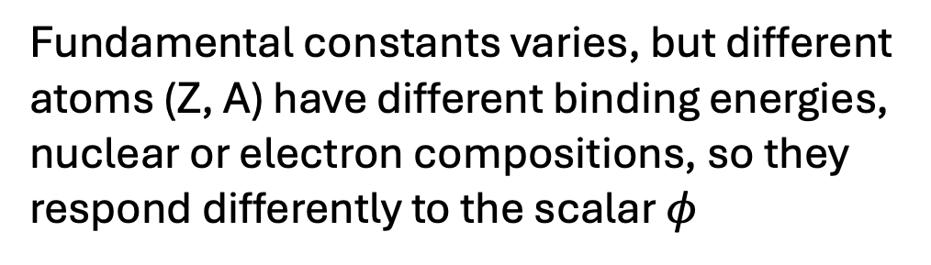
Quadratically Coupled ULDM
Implement $ℤ_{2}$ symmetry (inv under $φ→−φ$)
Fundamental constants varies, but different atoms (Z, A) have different binding energies, nuclear or electron compositions, so they respond differently to the scalar $φ$
EP violation!

Slide 4
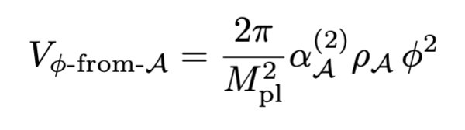
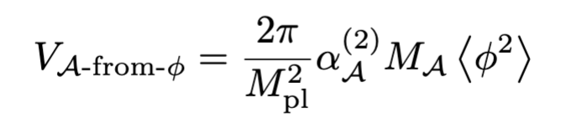
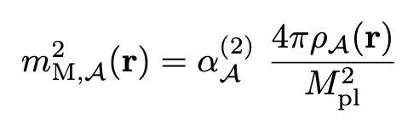
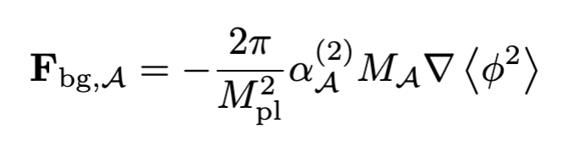

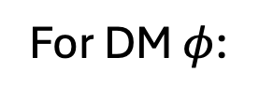
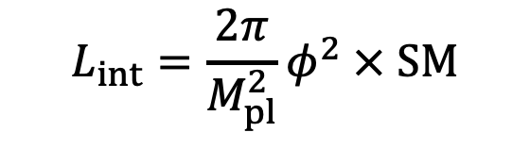
Matter Effect for DM from macroscopic SM
$$L_{int}=\frac{2π}{M_{pl}^{2}}φ^{2} × SM$$
For DM $φ$:
For macroscopic objects:
matter-induced scalar mass, inside object A
Background force due to $φ^{2}$ field’s presence!
$φ^{2}$ field re-distribution due to SM matter presence!

Slide 5
Matter Effect for DM from macroscopic SM
$$L_{int}=\frac{2π}{M_{pl}^{2}}φ^{2} × SM$$
For DM $φ$:
For macroscopic objects:
matter-induced scalar mass, inside object A
Background force due to $φ^{2}$ field’s presence!
$φ^{2}$ field re-distribution due to SM matter presence!

Slide 6



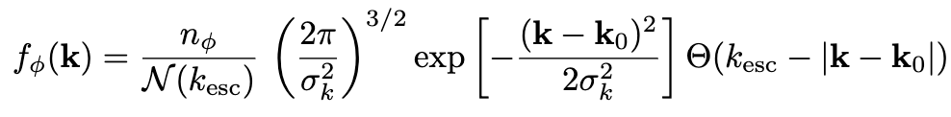


Blowin' In the (DM) Wind
Earth moving in the galaxy
$v_{0}=$ 238 km/s
In the Earth frame:
number density of DM w/ energy density of 0.3 GeV / cm³
~ escape velocity of the galaxy
$$k_{0}=m_{φ}v_{0}$$
DM wind ‘average’ momentum

Slide 7
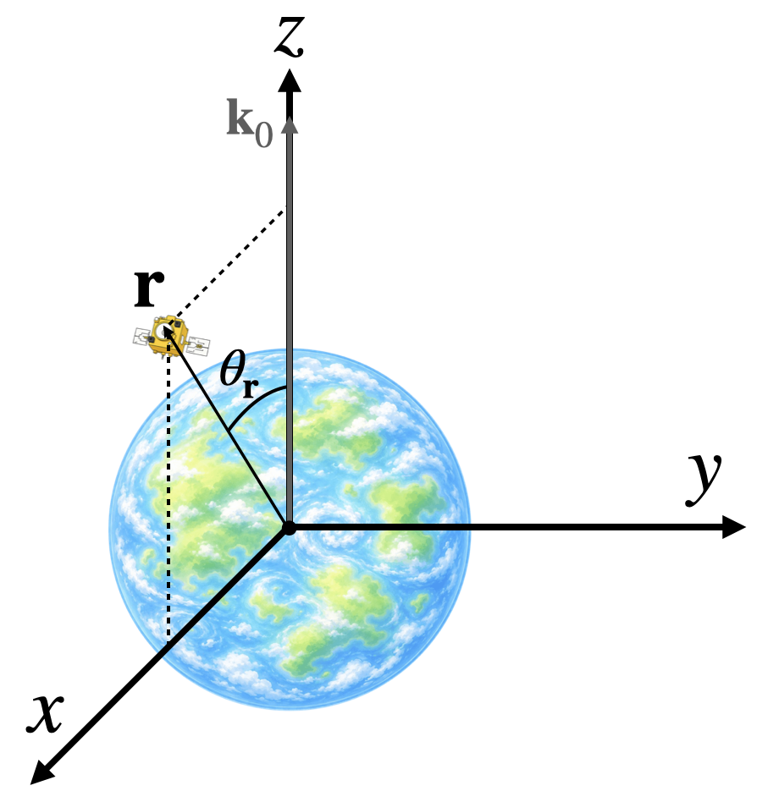
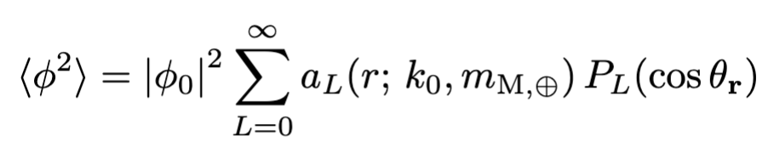

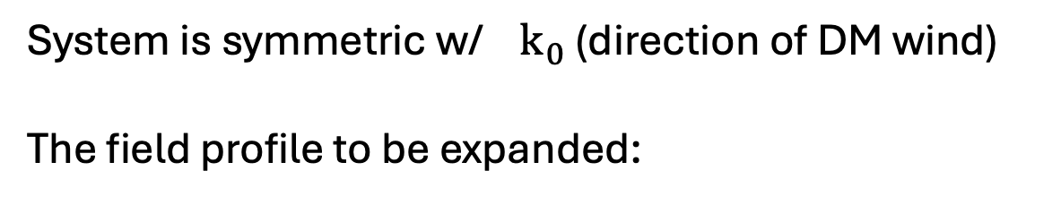
ULDM Scattered by the Earth $⊕$
System is symmetric w/ $k_{0}$ (direction of DM wind)
The field profile to be expanded:

Slide 8
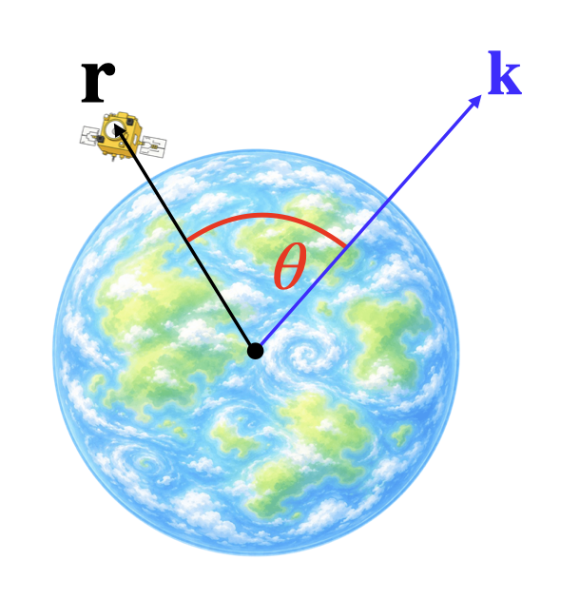


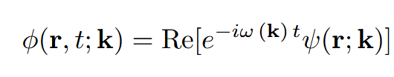
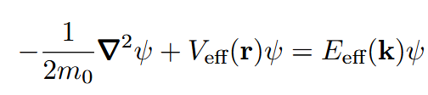
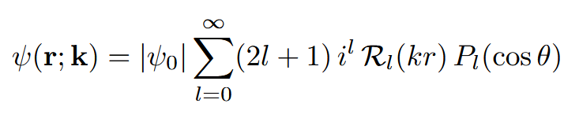
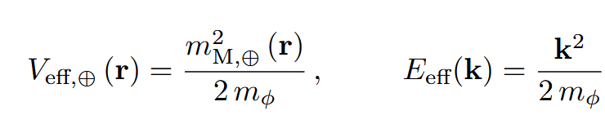

ULDM Scattered by the Earth $⊕$
Klein-Gordon equation:
For a mono-chromatic wave, in the NR limit:
Schrödinger equation:
partial-wave solution:

Slide 9
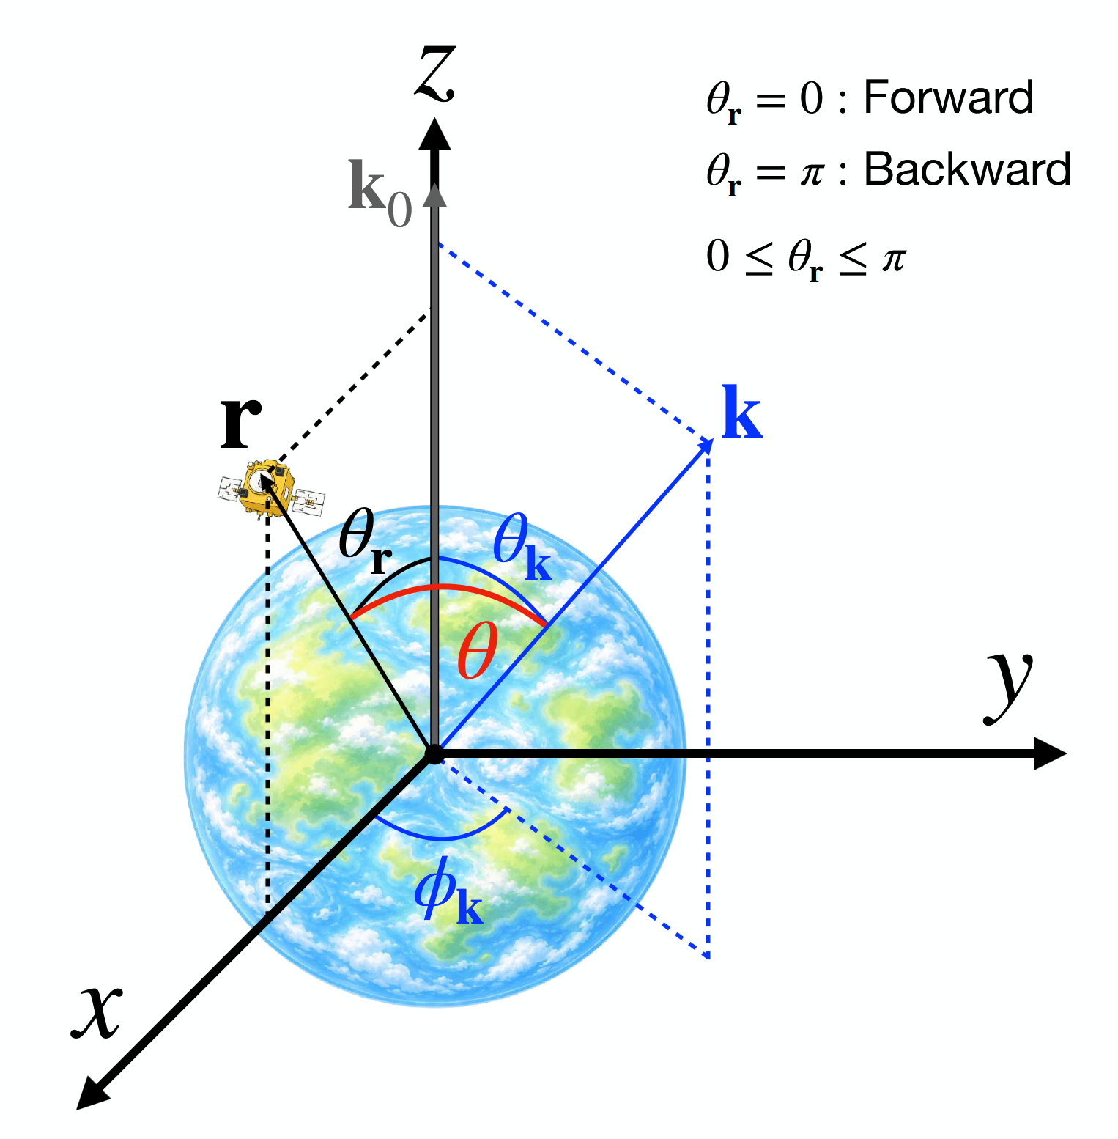
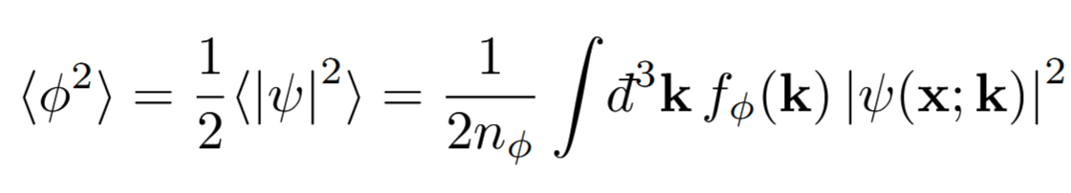
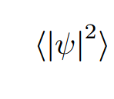
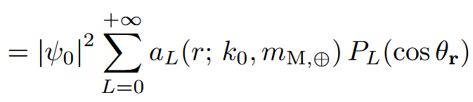
Phase Space Average
average over time and phase-space distribution:
with:

Slide 10
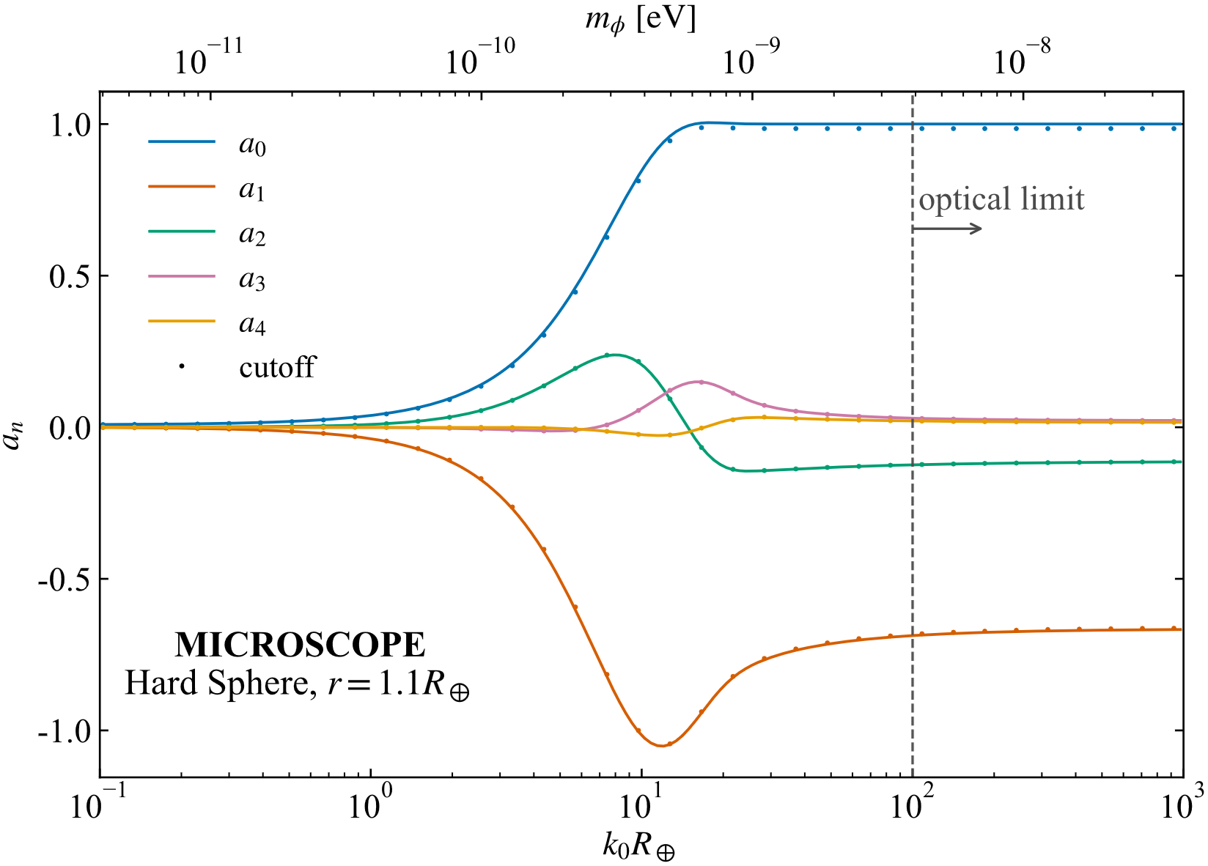
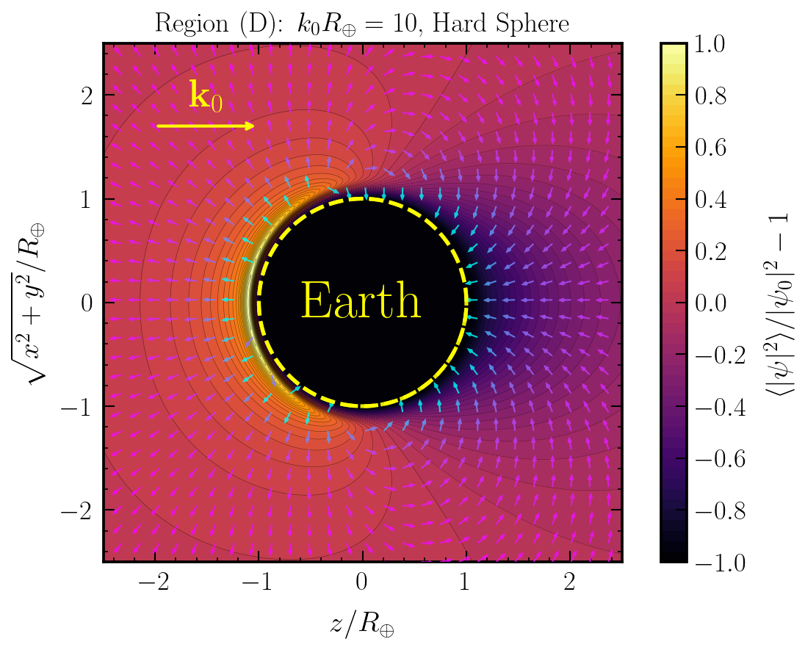
Multipole Expansion

Slide 11
Matter Effect for DM from macroscopic SM
$$L_{int}=\frac{2π}{M_{pl}^{2}}φ^{2} × SM$$
For DM $φ$:
For macroscopic objects:
matter-induced scalar mass, inside object A
Background force due to $φ^{2}$ field’s presence!
$φ^{2}$ field re-distribution due to SM matter presence!

Slide 12
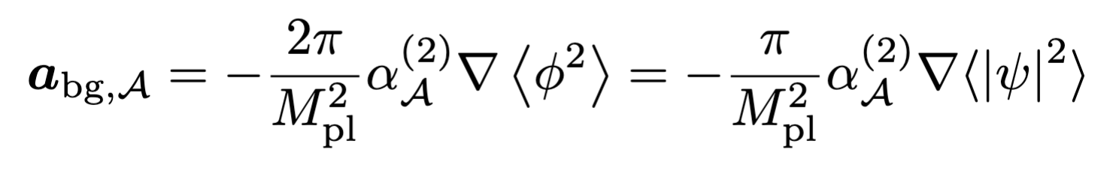
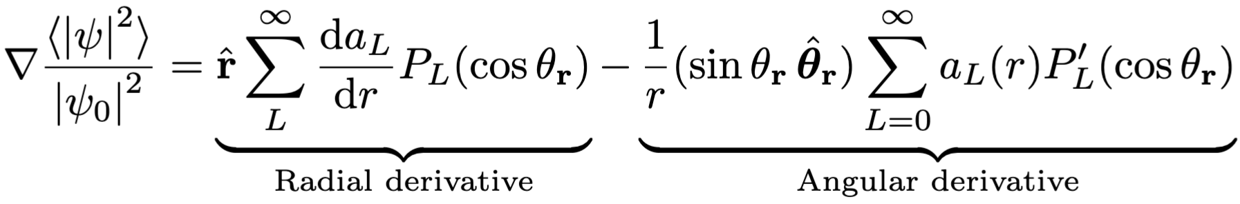
Background Force
From scalar-induced potential, its gradient introduces background force/acceleration on macroscopic objects.
decomposition to radial and tangential:

Slide 13
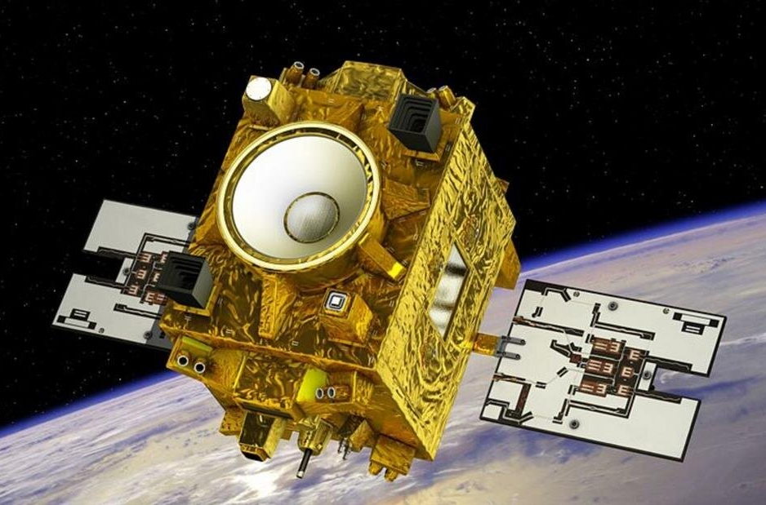
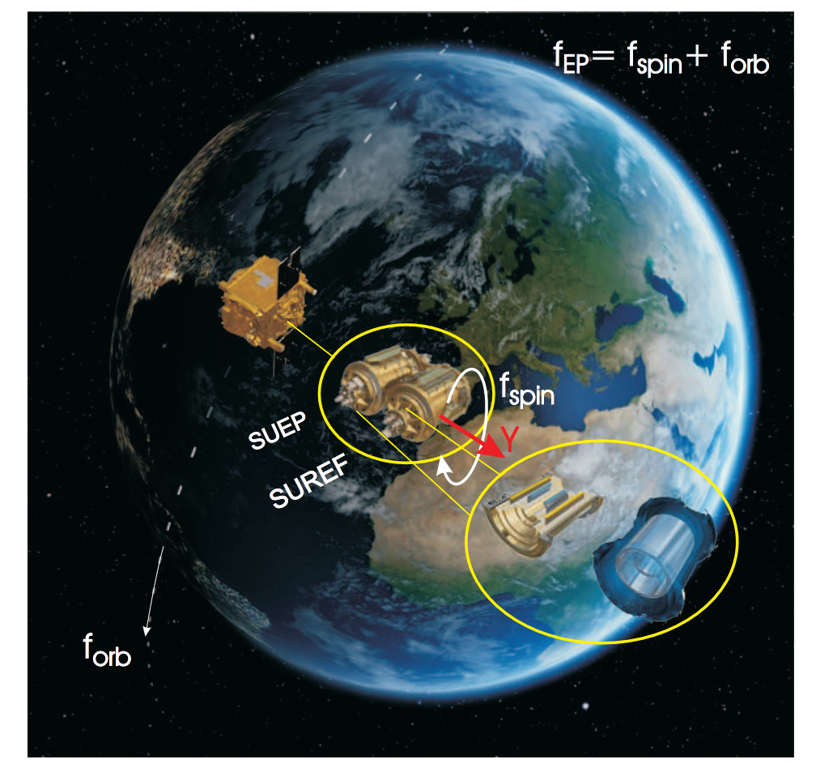
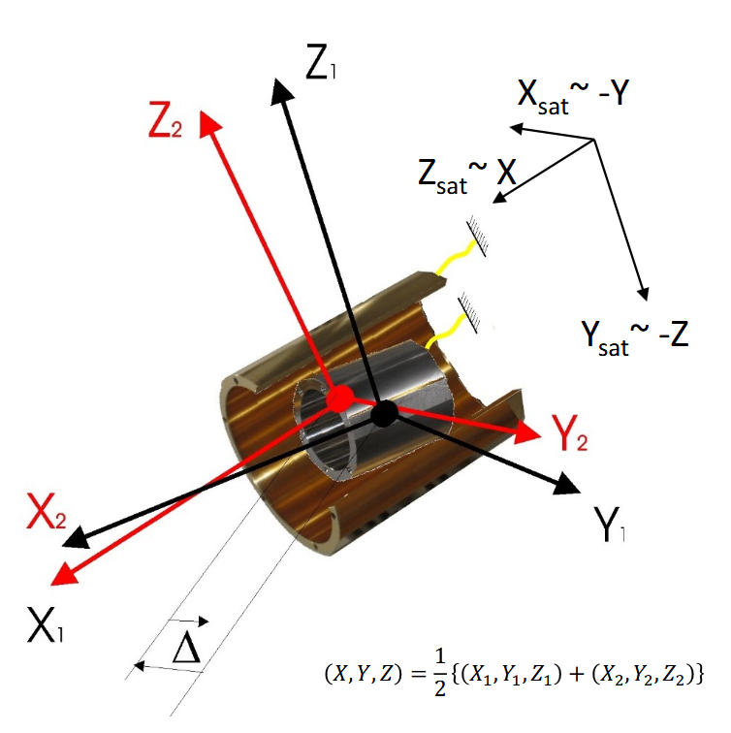
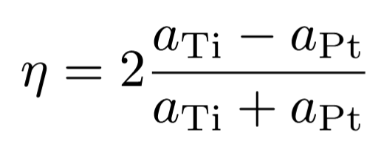
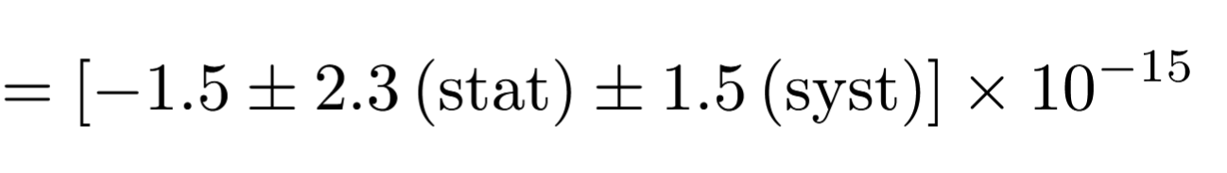
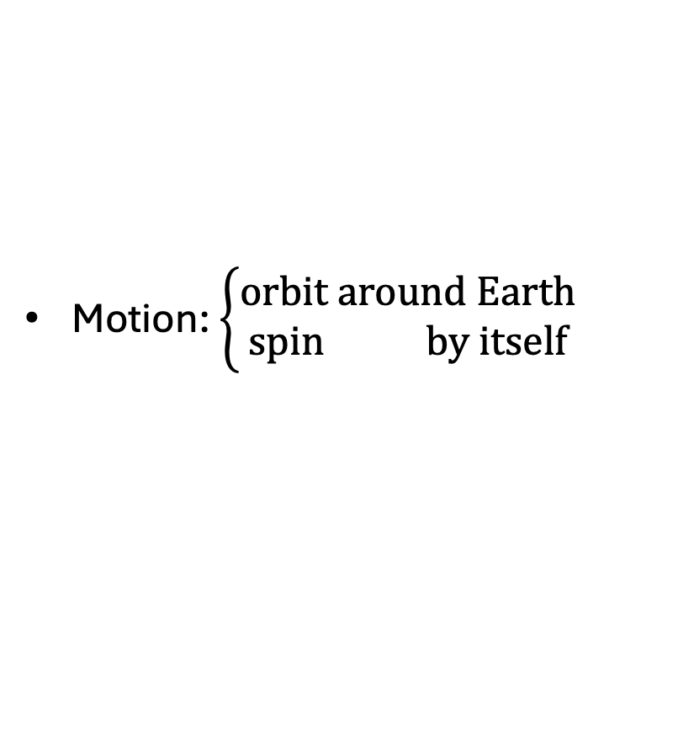
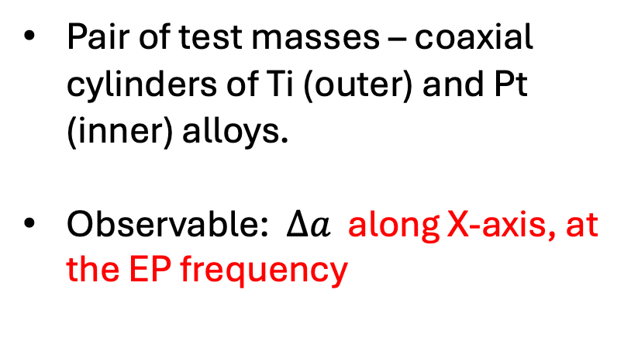
MICROSCOPE
Motion: $\left\{\begin{aligned}orbit around Earth \\ spin by itself\end{aligned}\right.$
Pair of test masses – coaxial cylinders of Ti (outer) and Pt (inner) alloys.
Observable: $Δa$ along X-axis, at the EP frequency
EP-test from April 25, 2016 to October 16, 2018

Slide 14
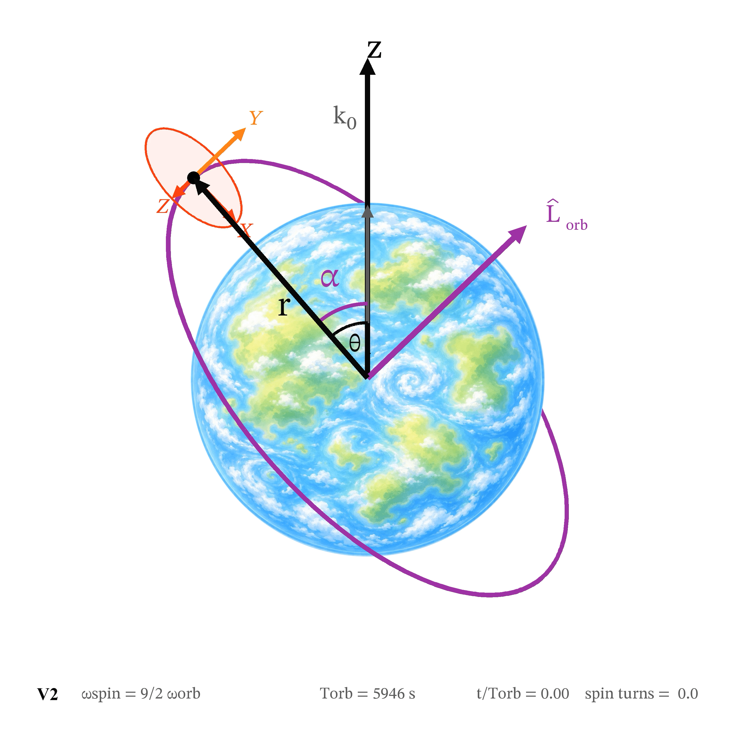
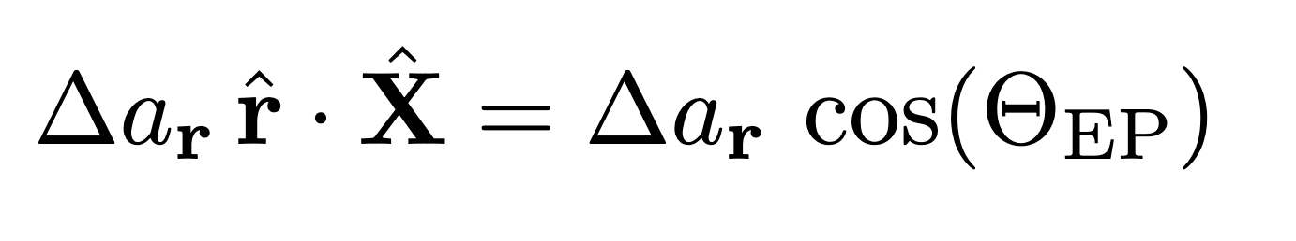
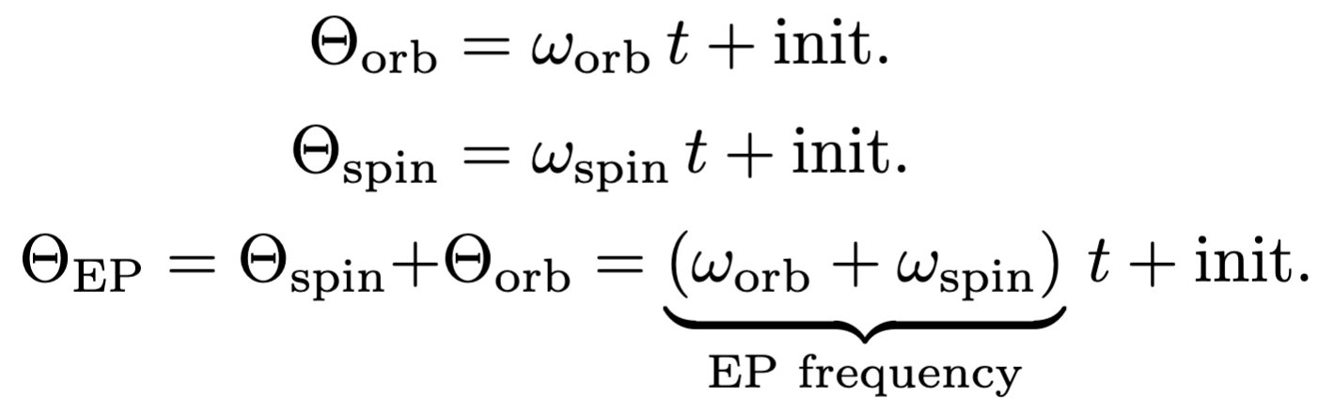
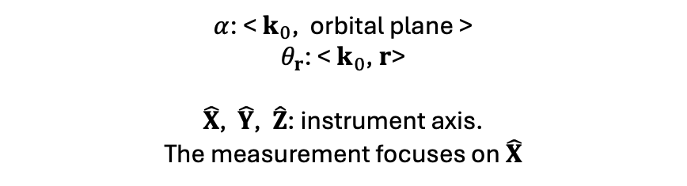
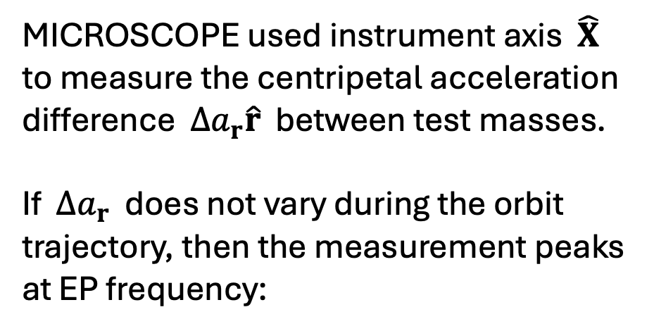
Along X-axis, at the EP Frequency?
MICROSCOPE used instrument axis $\hat{X}$ to measure the centripetal acceleration difference $Δa_{r}\hat{r}$ between test masses.
If $Δa_{r}$ does not vary during the orbit trajectory, then the measurement peaks at EP frequency:
$α$: < $k_{0}$, orbital plane >
$θ_{r}$: < $k_{0}$, $r$>
$\hat{X}$, $\hat{Y}$, $\hat{Z}$: instrument axis.
The measurement focuses on $\hat{X}$

Slide 15
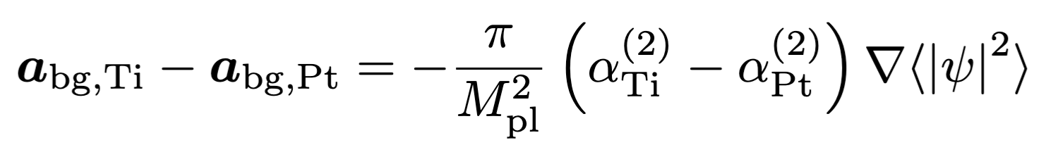
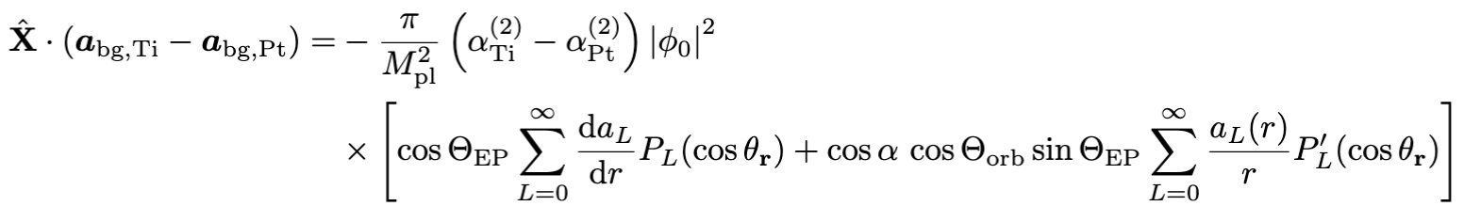
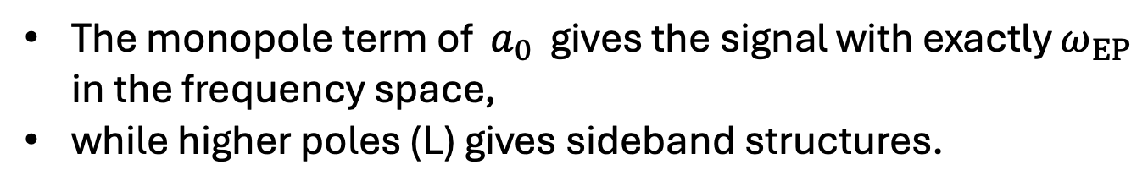
Along X-axis, All Frequencies
Difference of acceleration along instrument X-axis
The monopole term of $a_{0}$ gives the signal with exactly $ω_{EP}$ in the frequency space,
while higher poles (L) gives sideband structures.

Slide 16
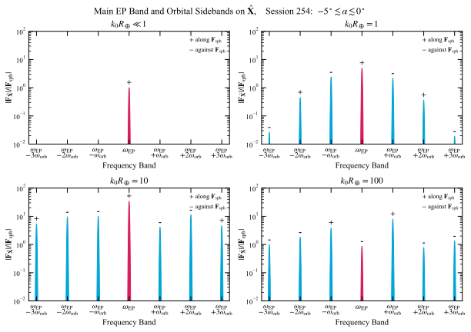
Signals: Frequency Band Structures

Slide 17
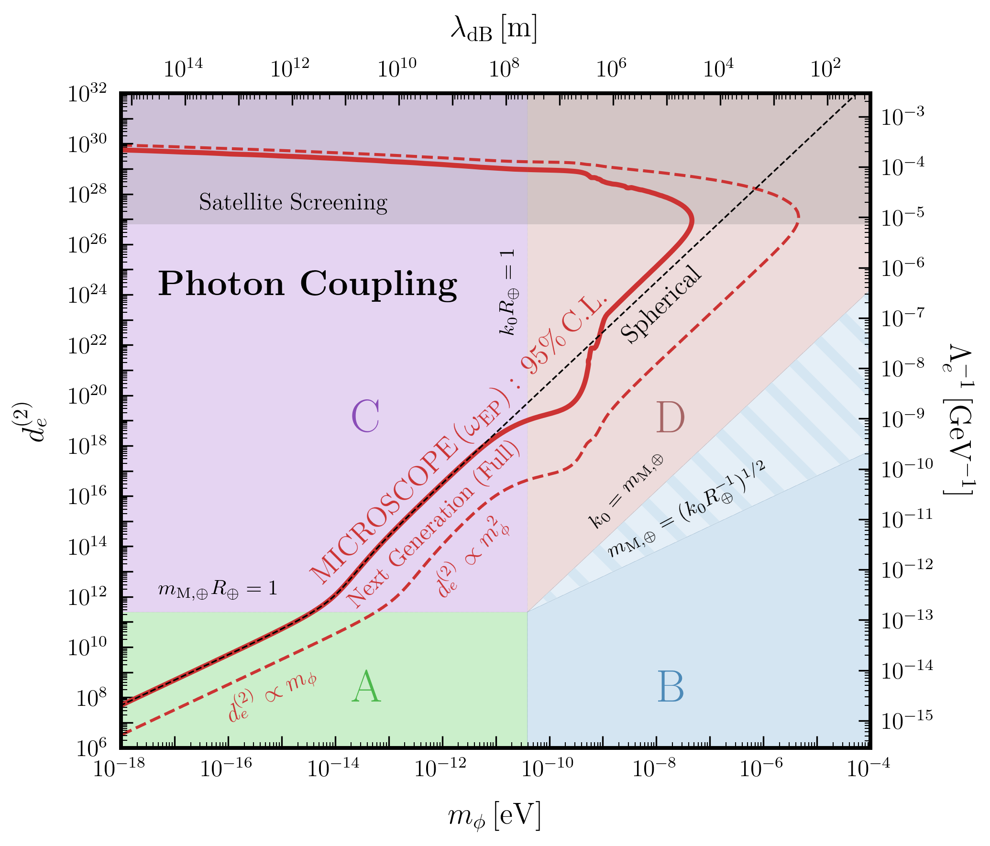
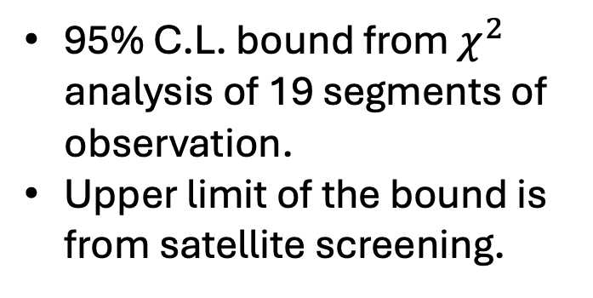
Constraints and Projections
95% C.L. bound from $χ^{2}$ analysis of 19 segments of observation.
Upper limit of the bound is from satellite screening.

Slide 18
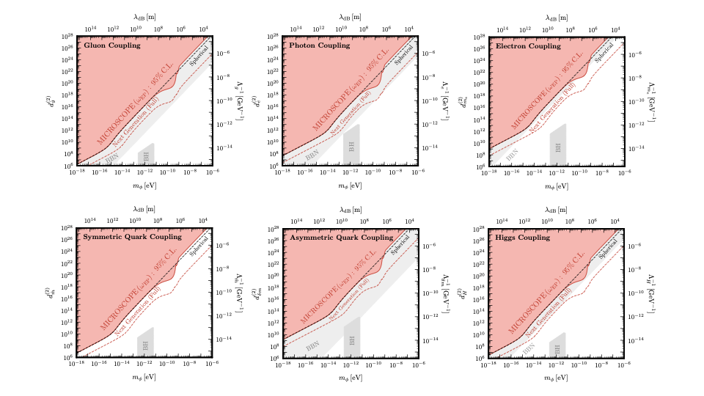
Other Couplings

Slide 19




Thank you!
Xucheng Gan
DESY
Tien-Tien Yu
UO
Hailin Xu
Adirondack Park, NY
Thomas Bouley
UO & Cincinnati State

Slide 20
