Slide 1

Gravitational Waves
and
Black Hole Environment
Chen Yuan (袁晨)
yuanchen@shu.edu.cn
Based on PRD 104, 044011 (2021) · PRD 106, 023020 (2022) · Phys.Rev.D 111 (2025) 6, 063048
In preparation: Guo et al.; Yuan & Cardoso; Xu & Yuan — arXiv:26XX.XXXX
Collaborators: Richard Brito, Vitor Cardoso, Francisco Duque, Yin-Da Guo, Qing-Guo Huang, Yang Jiang, Jing-Ze Xu and Ziri Younsi
Notes:
[0:00–0:35] Good afternoon. I will discuss how a black-hole environment can become visible in gravitational waves, using two examples: ultralight boson clouds and accretion flows. I will finish with new, ongoing work with Jing-Ze Xu on tilted disks. The published papers and preprints are listed here. The Técnico and GRIT logos acknowledge where much of this research was carried out; they do not indicate my current employment, membership, or funding.
[Sources]
- https://arxiv.org/abs/2106.00021
- https://arxiv.org/abs/2204.03482
- https://arxiv.org/abs/2502.07871
- User-provided placeholders: Guo et al.; Yuan & Cardoso; Xu & Yuan — arXiv:26XX.XXXX.
- Authentic institutional logos inherited from the user-provided source deck.

Slide 2
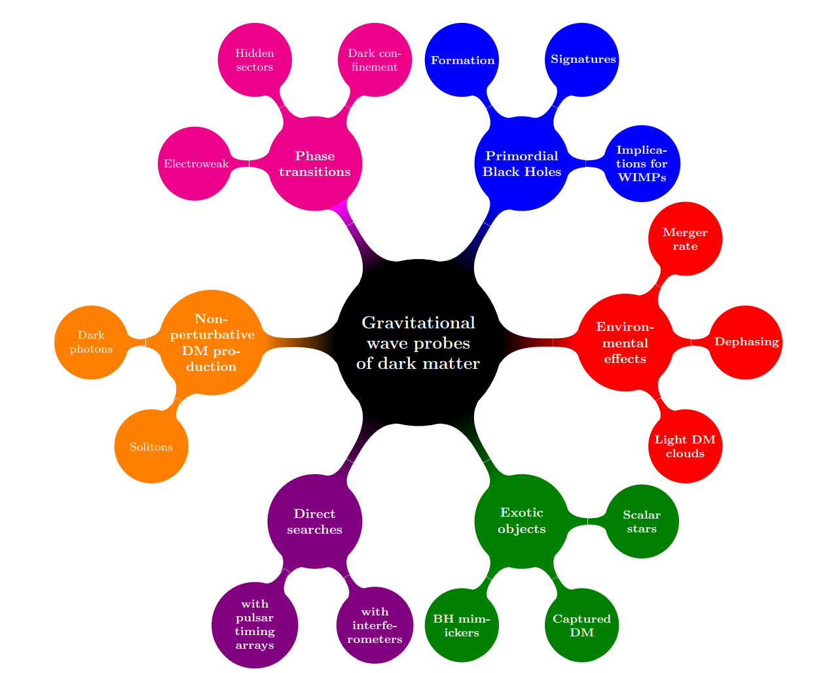
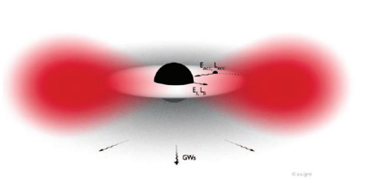
BH environment
G. Bertone et al. (2020)
Notes:
[0:35–1:15] Astrophysical black holes are not isolated. They can be surrounded by dark-matter fields, plasma, accretion disks, stars, and companion objects. Each environment perturbs the spacetime in a different way. The question connecting the talk is therefore: which environmental degrees of freedom leave a measurable gravitational-wave signature, and which mainly change the black hole's long-term evolution?
[Sources]
- User-provided source deck, original slide 2; Bertone et al. (2020) as cited on the slide.

Slide 3
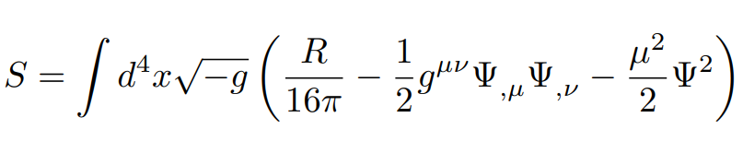
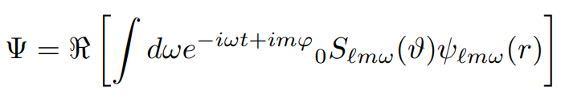



Ultralight DM
Massive bosonic fields in Kerr space time
General solution
Boundary conditions: horizon acts as a dissipative membrane
Eigenfrequencies
The bosonic field is extracting energy from the BH when
Brito et al. (2017)
Notes:
[1:15–2:20] I start with ultralight bosons. Around a Kerr black hole, a massive bosonic field admits quasi-bound states. The horizon is dissipative, so a mode satisfying the superradiant condition can extract rotational energy and grow into a macroscopic cloud—a gravitational atom. The detailed equations are shown here, but the physical point is simple: the black hole supplies energy, the cloud stores it, and the cloud can later radiate gravitational waves.
[Sources]
- User-provided source deck, original slide 3; Brito et al. (2017) as cited on the slide.

Slide 4
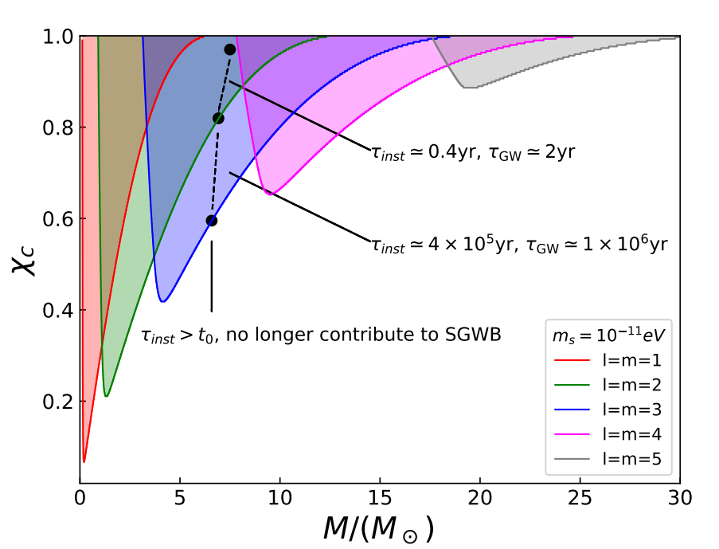
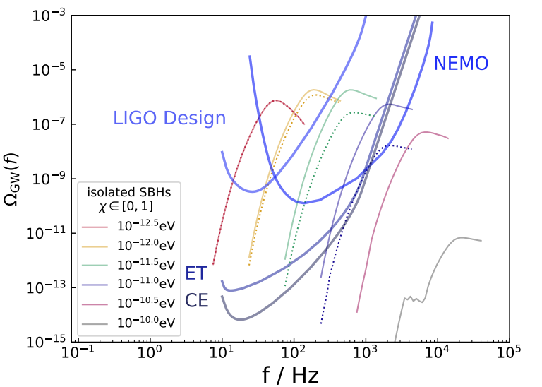
Ultralight DM
The contribution of higher l, m modes
GW emission dominated by higher modes
PRD 104, 044011 (2021)
Notes:
[2:20–3:20] A key result of our 2021 work is that one should not truncate the signal to the lowest multipoles over the full parameter range. On the left, the dominant unstable level changes with black-hole mass and boson mass. On the right, this feeds directly into the stochastic background. For boson masses above roughly ten to the minus twelve electron-volts, higher modes can dominate the gravitational-wave energy density and materially change the reach of future detectors.
[Sources]
- https://arxiv.org/abs/2106.00021
- User-provided source deck, original slide 5.

Slide 5
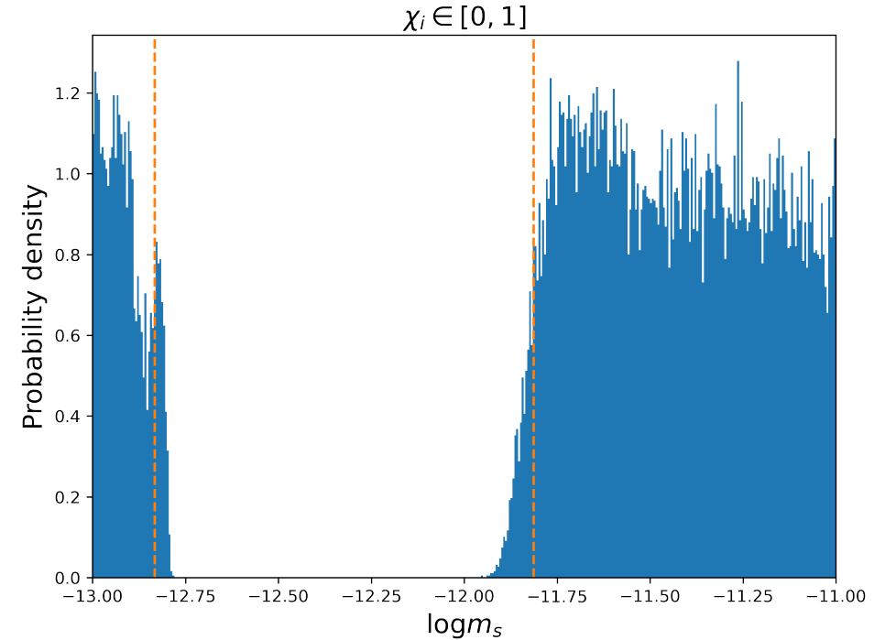
Ultralight DM
  Search for ultralight dark matter using LVK O1-O3 dataset
PRD 106, 023020 (2022)
Notes:
[3:20–4:10] We then confronted the full unstable-mode model with the first three observing runs of Advanced LIGO and Virgo. The Bayesian posterior shows no evidence for the predicted stochastic background. The non-detection becomes a constraint: depending on the assumed black-hole spin distribution, it excludes a broad scalar-boson mass interval around ten to the minus thirteen electron-volts. This is an example where adding the mode structure strengthens the inference, rather than only refining the waveform.
[Sources]
- https://arxiv.org/abs/2204.03482
- User-provided source deck, original slide 7.

Slide 6
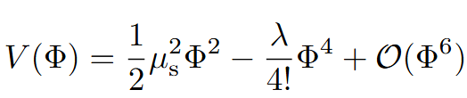
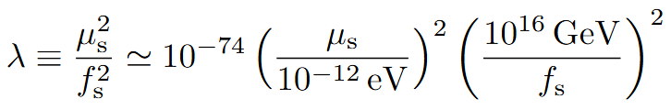
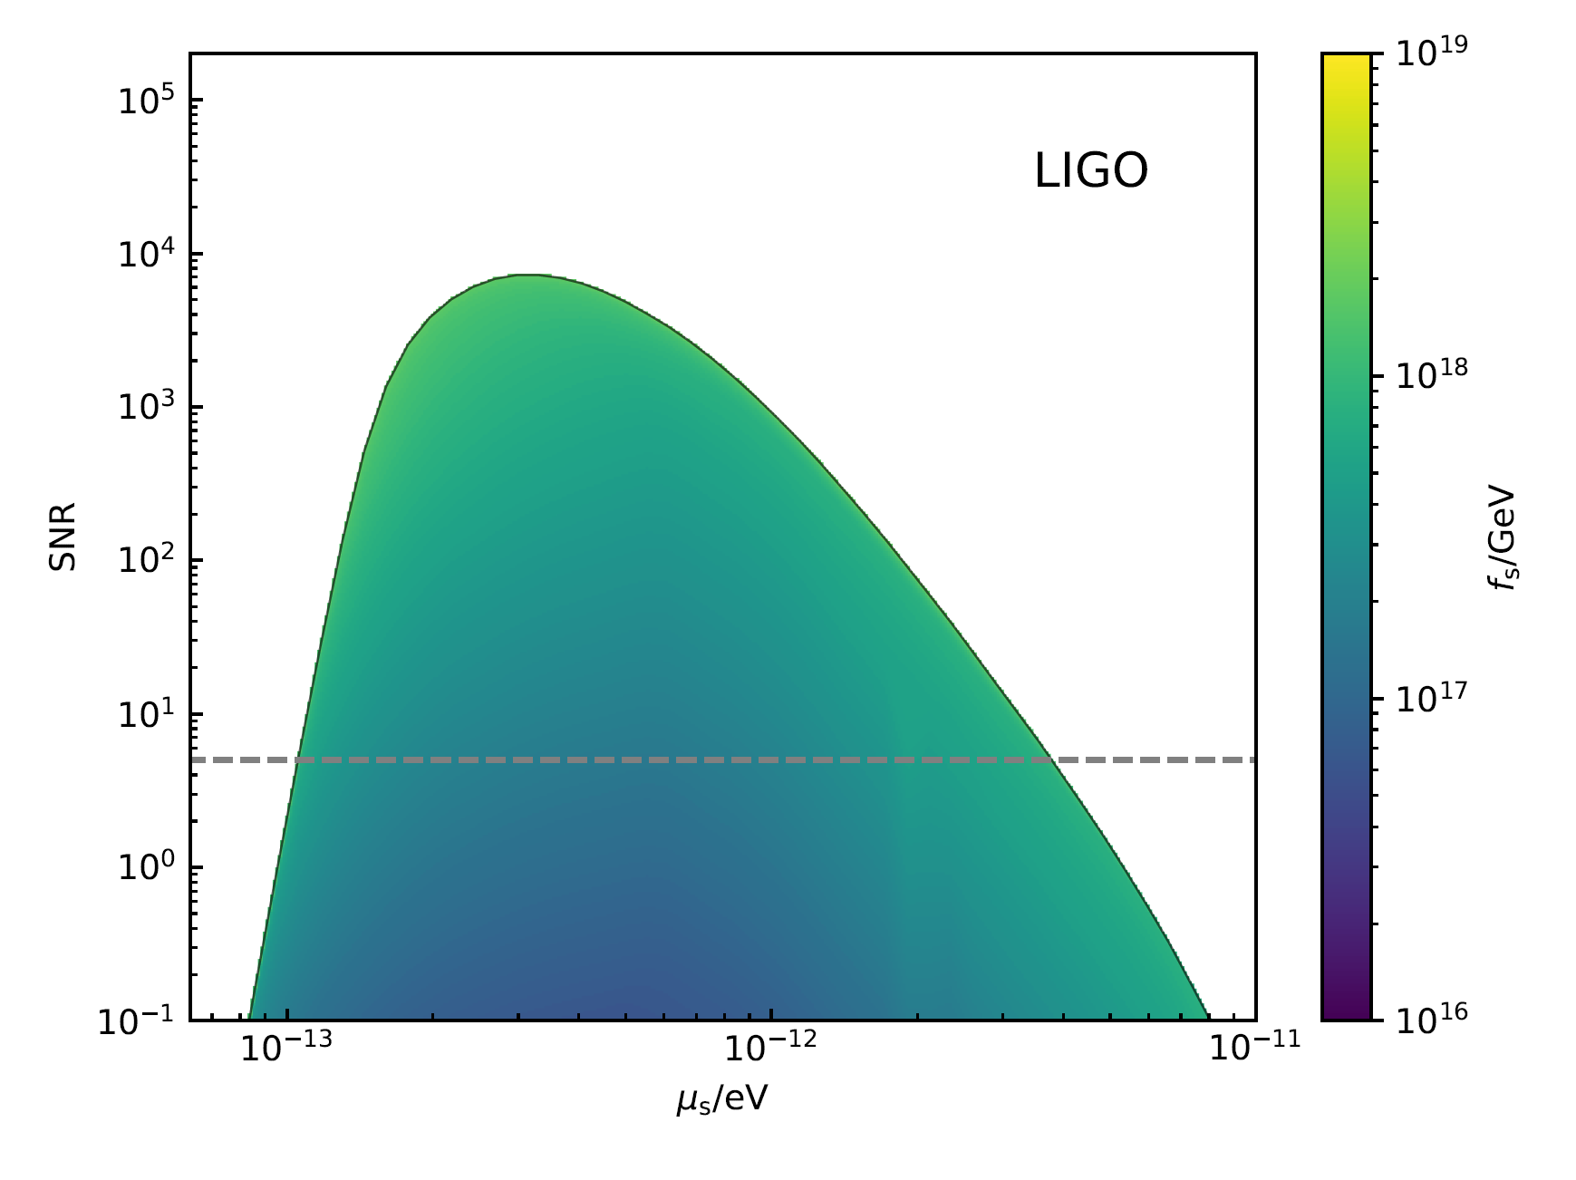
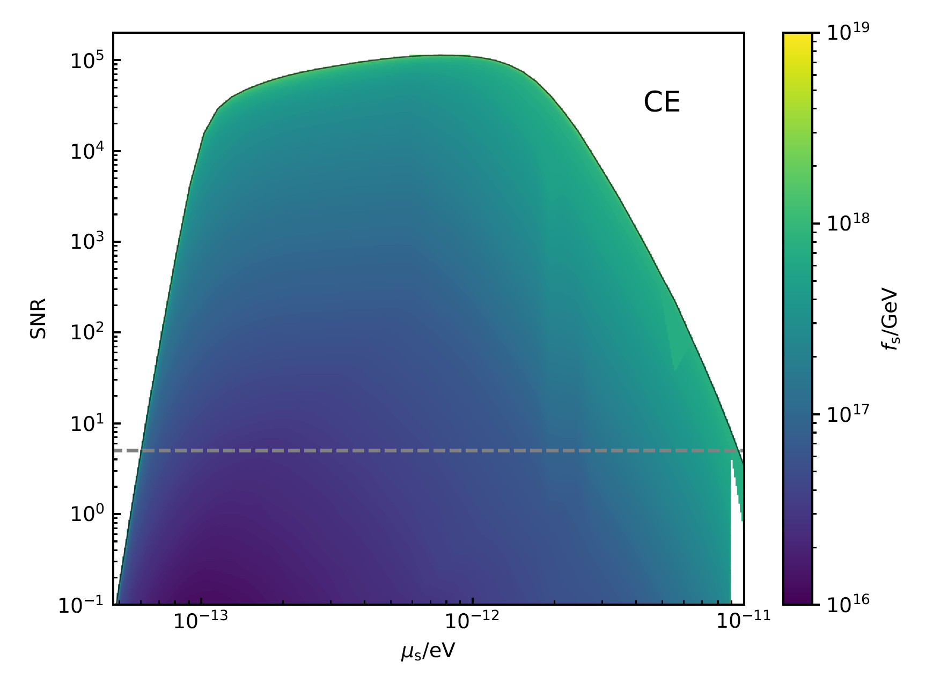
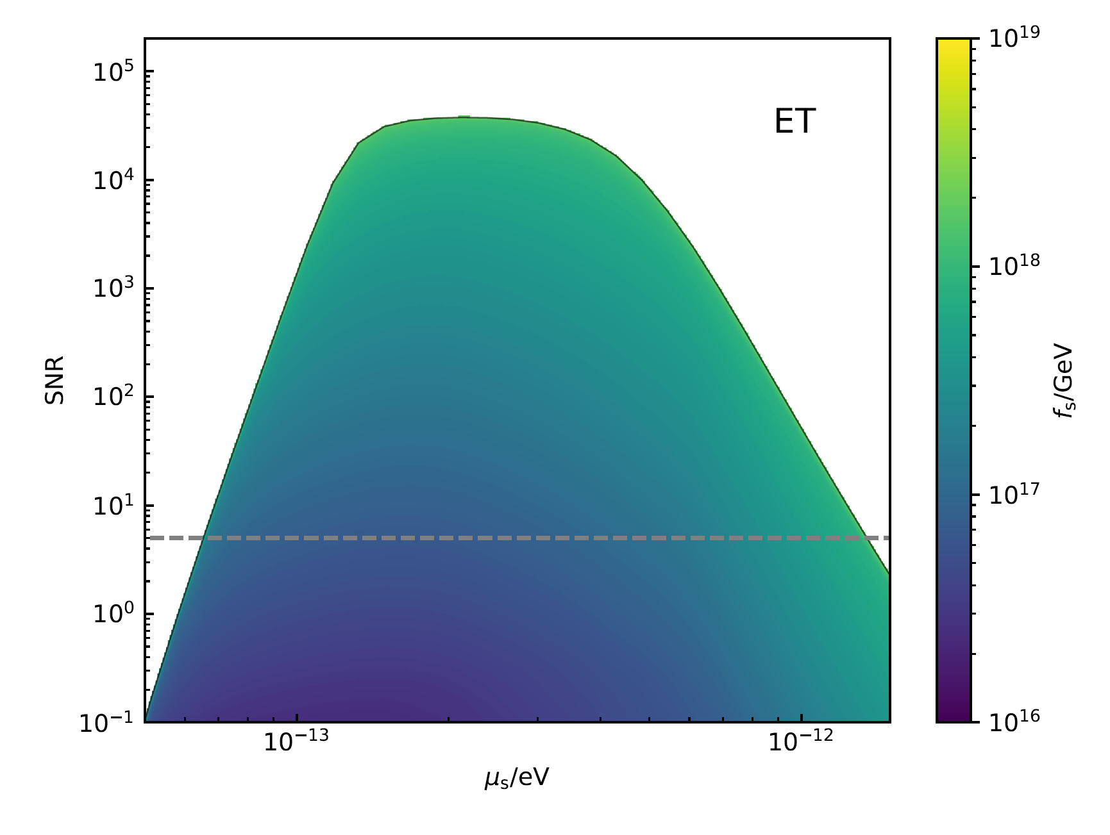
Ultralight DM
With self-interaction
Guo et al. arXiv 26XX.XXXX
Notes:
[4:10–5:15] The next question is what happens when the boson is not free. Self-interactions couple cloud levels that would otherwise evolve almost independently. The three panels summarize how the accessible parameter space changes for current and future detectors. The important message for this talk is qualitative: self-interactions can redirect energy among modes, add scalar-emission channels, and alter both the lifetime and gravitational-wave output of the cloud. This ongoing work is with Guo and collaborators.
[Sources]
- User-provided source deck, original slide 10.
- Guo et al., arXiv:26XX.XXXX — placeholder supplied by the user.

Slide 7


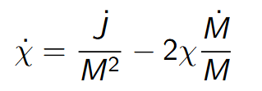
BH Environment
Baseline theory: thin-disk limit and the Novikov–Thorne (NT) limit
GR light bending makes a non-negligible fraction of disk photons fall into the BH and modify the BHspin.
NT limit (ideal thin disk)
Spin limits
Geometrically thin disk.
Gas inspirals to ISCO, then plunges.
BH gains mass and angular momentum from inflow(and captured radiation).
…
Neglect GR light bending:
Including GR light bending:
Spin evolution rate
Limitations
No magnetic torque across ISCO
Steady
Axisymmetric
…
Yuan & Cardoso arXiv:26XX.XXXX
Notes:
[5:15–6:20] I now switch from bosonic fields to ordinary accretion. The familiar Novikov–Thorne limit assumes a thin, steady, axisymmetric disk and negligible magnetic torque across the ISCO. Photon capture lowers the idealized spin limit from one to about 0.998. These assumptions are clean, but real disks are magnetized and turbulent. We therefore asked whether a dynamical GRMHD flow selects a different equilibrium spin.
[Sources]
- User-provided source deck, original slide 12.
- Yuan & Cardoso, arXiv:26XX.XXXX — placeholder in the source deck.

Slide 8
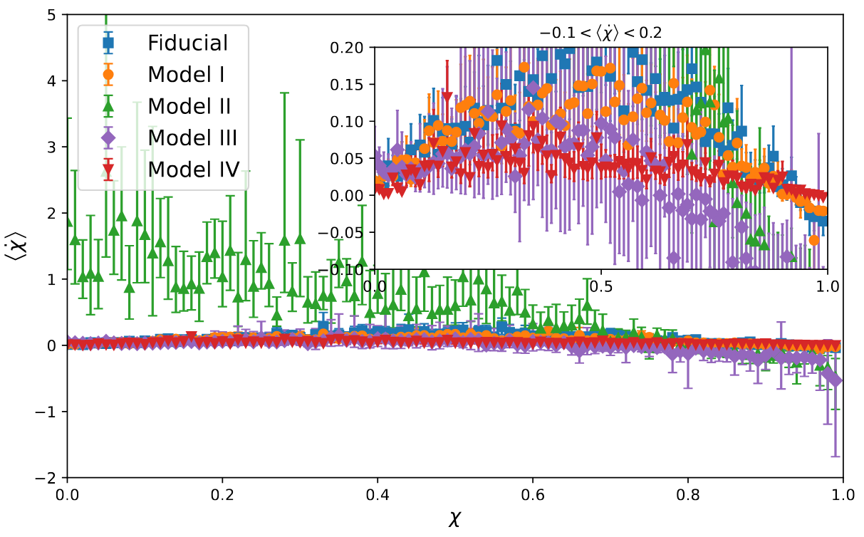





BH Environment
Equilibrium spins
Summary
Fiducial:
All configurations:
Model III: earlier spin-down,
Model IV: higher equilibrium spin，
Physical picture
Larger net magnetic flux lower Equilibrium spin
Weaker net magnetic flux higher Equilibrium spin
Yuan & Cardoso arXiv:26XX.XXXX
Notes:
[6:20–7:30] Across our GRMHD survey, the equilibrium spin is controlled by the net horizon fluxes of energy and angular momentum. The fiducial configuration settles near a spin of 0.94, and the full set spans lower values than the ideal thin-disk limit. The physical trend is robust: a larger net magnetic flux and a stronger jet extract more angular momentum, producing a lower equilibrium spin; weaker flux permits a higher one.
[Sources]
- User-provided source deck, original slide 18.
- Yuan & Cardoso, arXiv:26XX.XXXX — placeholder in the source deck.

Slide 9


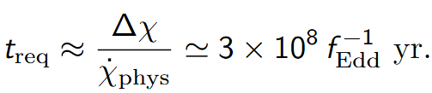
BH Environment
Astrophysical implication
Scaling (choose an accretion rate)
Example at z = 4
Implications for “extremal spin” physics
Accretion-driven spins are limited by magnetic fields/jets: in our survey
Observed high spins can qualitatively infer accretion history
Gravitational waves?
Yuan & Cardoso arXiv:26XX.XXXX
Notes:
[7:30–8:15] This changes how we should interpret an observed near-extremal spin. It is not only a statement about how much mass was accreted. It also constrains the magnetic topology, jet efficiency, and accretion history. Conversely, a sub-extremal spin can be the natural outcome of a long-lived magnetized flow, not necessarily evidence that the black hole is young or weakly fed.
[Sources]
- User-provided source deck, original slide 19.
- Yuan & Cardoso, arXiv:26XX.XXXX — placeholder in the source deck.

Slide 10
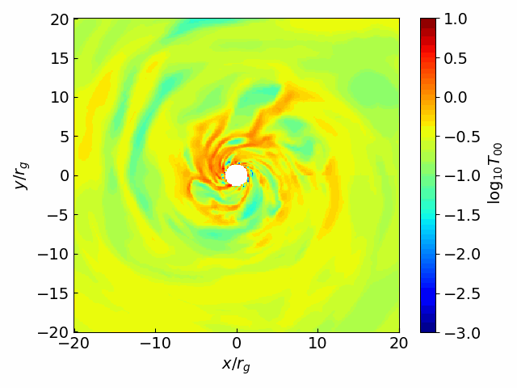





BH Environment
Gravitational Waves from Accretion Disks
GRMHD simulation
Teukolsky solver
Single-source GW
SGWB
3D turbulent accretion disk
Spin = 0.94
Use GRMHD stress-energy tensor
2nd-order Lax-Wendroff
2d
GW Waveform
GW energy spectrum
BH population
Fishbone-Moncrief torus,
Weak EM field:
resolution: 384 × 192 × 192 for
Stress-energy tensor extracted every
arXiv:2502.07871
Notes:
[8:15–9:30] The same turbulent disk can also be treated as a direct gravitational-wave source. Our pipeline begins with a three-dimensional GRMHD simulation. We extract its stress-energy tensor and use it as the source of the Teukolsky equation. This yields a waveform and energy spectrum for one system; a population model then gives a stochastic background. The separation is useful because it connects fluid dynamics, black-hole perturbation theory, and observables without replacing the disk by a simple quadrupole estimate.
[Sources]
- https://arxiv.org/abs/2502.07871
- User-provided source deck, original slide 20.

Slide 11
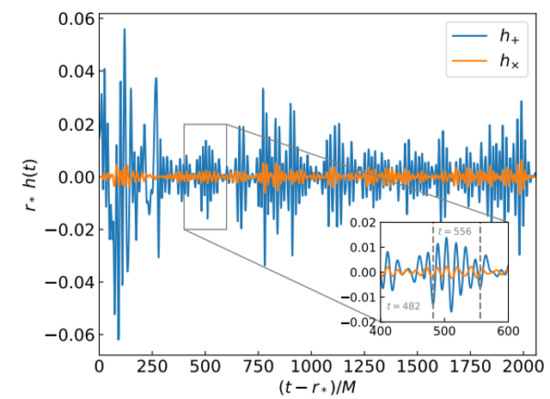
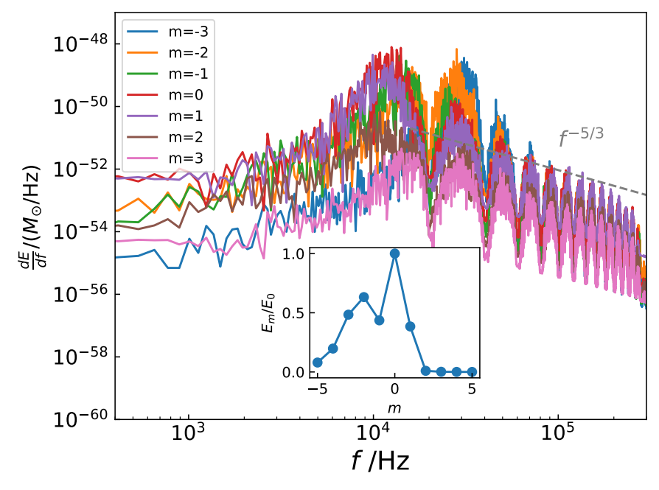
BH Environment
Turbulent accretion can stochastically excite BH quasinormal modes.
GW spectrum carries both QNM structure and a turbulence-like tail.
arXiv:2502.07871
Notes:
[9:30–10:45] The time-domain signal is stochastic because it is driven by turbulence, but the black hole still acts as a resonant filter. The spectrum therefore carries recognizable quasinormal-mode structure together with a broader turbulence-like tail. For stellar-mass populations the background is far below third-generation ground-based sensitivity. Supermassive, actively accreting black holes can reach roughly ten to the minus fifteen in Omega-GW in the microhertz band, still below current PTA and LISA reach. The main value today is the clean physical prediction and the framework for more realistic disks.
[Sources]
- https://arxiv.org/abs/2502.07871
- User-provided source deck, original slide 21.

Slide 12
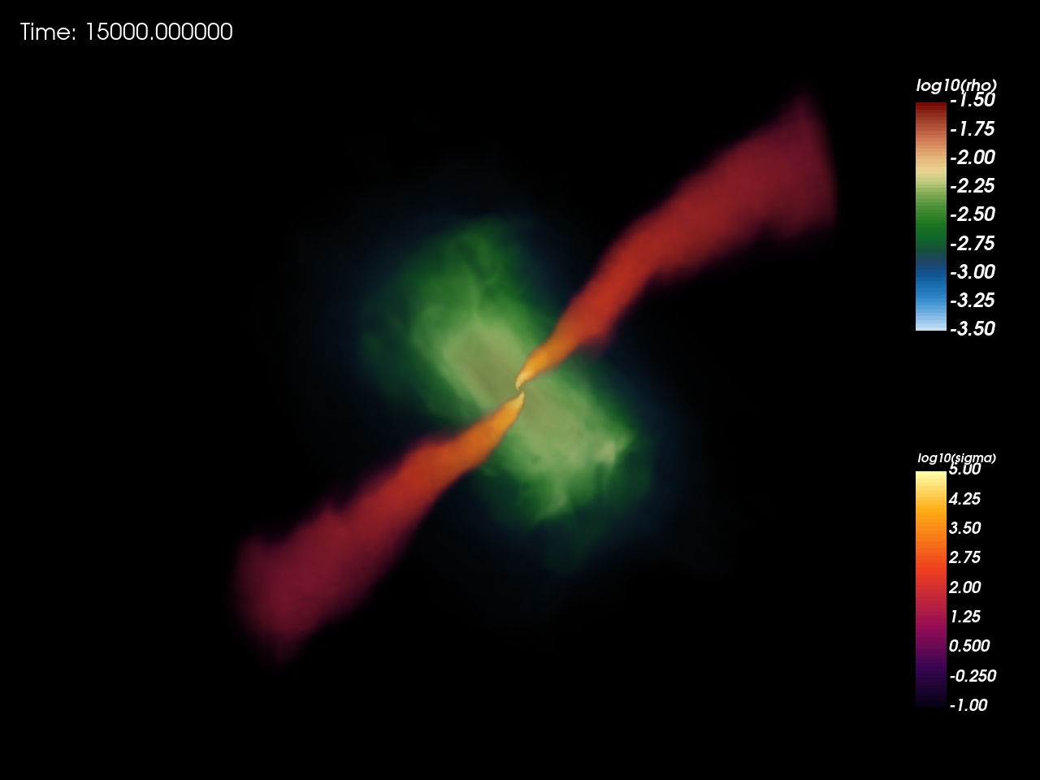
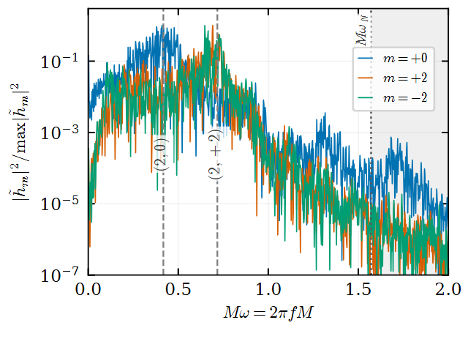
BH Environment
Tilt disk redistributes GW power
Xu & Yuan arXiv:26XX.XXXX
Notes:
[10:45–12:40] This brings me to the new result with Jing-Ze Xu. The left panel shows the strongly non-axisymmetric, tilted turbulent flow. We decompose the gravitational radiation into spherical-harmonic components and compare the energy in each l,m mode for an aligned disk and a disk tilted by seventy-five degrees. The first two heat maps show the absolute mode energies; the third shows their ratio. Tilt does not merely rescale the total signal. It redistributes power across mode space, with many high-absolute-m components enhanced relative to the aligned case. That gives us a more diagnostic observable than the total spectrum alone and may help connect waveform morphology to disk orientation. The analysis is ongoing, so I present this as a robust numerical trend rather than a finalized detectability claim.
[Sources]
- User-provided tilted-disk density image: codex-clipboard-85a22122-30c0-4b7c-8b8c-24b9884e7fa2.png.
- User-provided (l,m) energy-comparison image: codex-clipboard-d4e22dad-b57e-4ebf-a7ad-7e1521edca65.png.
- Xu & Yuan, arXiv:26XX.XXXX — placeholder supplied by the user.

Slide 13
Summary
Ultralight bosons around spinning BHs can trigger superradiant instabilities, form gravitational atoms, and generate observable GW signatures.
Self-interactions can modify the evolution of boson clouds, opening new channels of mode coupling, scalar emission, and GW phenomenology.
Accretion environments play a key role in BH spin evolution, leading to an equilibrium spin that depends on the EM field around a BH.
Turbulent disks excite BH quasi-normal modes, while disk tilt redistributes GW power across m modes.
Notes:
[12:40–14:10] Let me close with four points. First, ultralight bosons can turn a spinning black hole into a gravitational atom, and higher modes matter for the observable background. Second, self-interactions change the mode-coupling network and therefore the phenomenology. Third, magnetized accretion selects an equilibrium spin below the ideal thin-disk limit, linking spin measurements to magnetic flux and jets. Finally, turbulent disks excite black-hole modes, and our new tilted-disk calculation shows that orientation leaves a clear imprint in the l,m energy distribution. Together these examples show that gravitational waves can probe not only the black hole, but also the dynamical environment around it. Thank you.
[Sources]
- https://arxiv.org/abs/2106.00021
- https://arxiv.org/abs/2204.03482
- https://arxiv.org/abs/2502.07871
- User-provided ongoing-work placeholders and figures.

